Slide 1
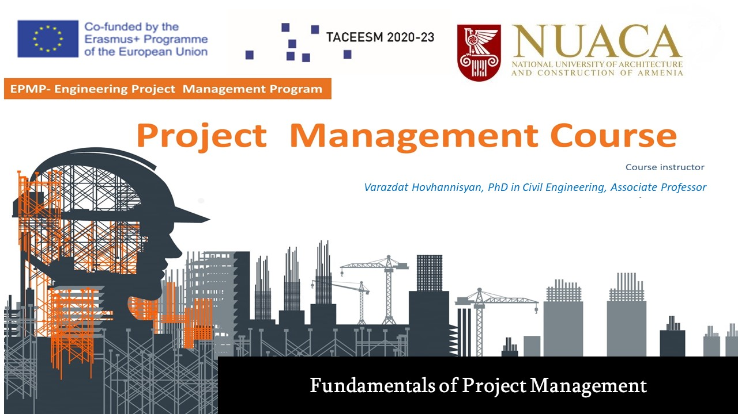

Slide 2

Project Management Background
The idea of project management started its history since 1917 and then it is developed via addition discoveries.

Slide 3
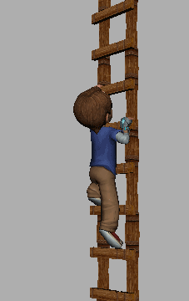
Some Facts from Project Management Background
2570 BC: The Great Pyramid of Giza Completed
208 BC: Construction of the Great Wall of China
1917: The Gantt chart Developed by Henry Gantt (1861-1919)
1956: The American Association of Cost Engineers (now AACE International) Formed
1958: The Program Evaluation Review Technique (PERT) Invented for the U.S. Navy's Polaris Project
1962: United States Department of Defense Mandate the Work Breakdown Structure (WBS) Approach
1965: The International Project Management Association (IPMA) Founded
1969: Project Management Institute (PMI) Launched to Promote the Project Management Profession
1975: PROMPTII Method Created by Simpact Systems Limited
1984: Theory of Constraints (TOC) Introduced by Dr Eliyahu M. Goldratt in his Novel "The Goal"
1986: Scrum Named as a Project Management Style
1987: A Guide to the Project Management Body of Knowledge (PMBOK Guide) Published by PMI

Slide 4
Some Facts from Project Management Background
1989: PRINCE Method Developed From PROMPTII
1996: PRINCE2 Published by CCTA
1997: Critical Chain Project Management (CCPM) Invented
2001: The Agile Manifesto Written
2006: "Total Cost Management Framework" Release by AACE International
2008: 4th Edition of PMBOK Guide Released
2009: Major PRINCE2 Revision by Office of Government Commerce (OGC)
2012: ISO 21500:2012 Standard for Project Management Released
2012: 5th Edition of PMBOK Guide Released
2017: PRINCE2 Second Major Revision by AXELOS
2017: 6th Edition of PMBOK Guide Released
2018: PRINCE2 Agile
2021: 7th Edition of PMBOK Guide Released

Slide 5
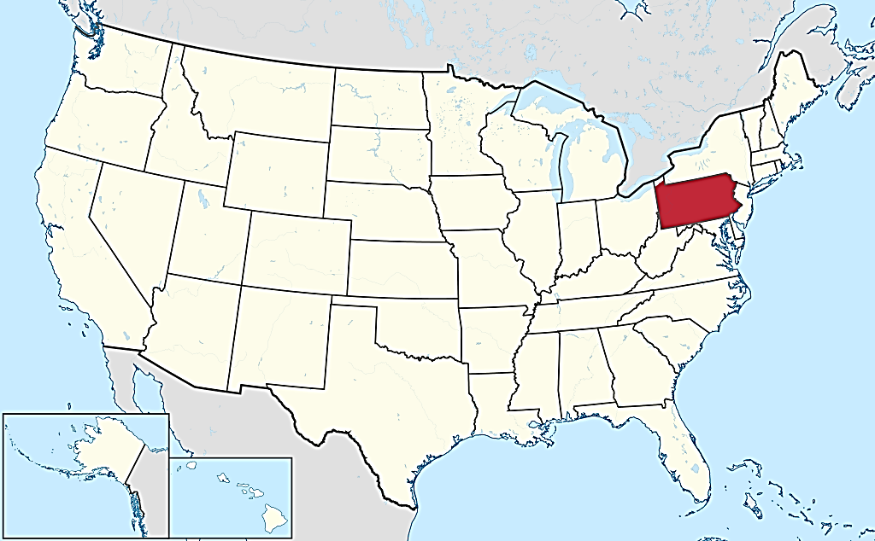
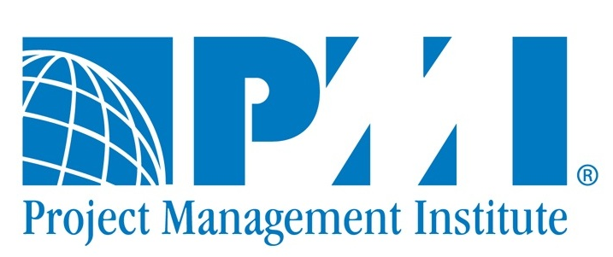
Project Management Institute (PMI)
Founded by 5 volunteers in 1969 in Pennsylvania (USA).

Slide 6


The basic Definitions
What is a Project and Project Management
Project Life Cycle
Project Manager, Team, Stakeholders

Slide 7


Slide 8
Project Definition
A Project is “a temporary endeavor undertaken to create a unique product, service, or result.”

Slide 9



The main Features of a Project
Goal
Time
Cost
Unique endeavor
Specific goal/objective
Defined beginning and end date
Budget, scope and time constrains

Slide 10
Temporary nature of Project
The temporary nature of projects indicates that a project has a definite beginning and end.
The end is reached when the project’s objectives have been achieved or when the project is terminated because its objectives will not or cannot be met, or when the need for the project no longer exists.

Slide 11
Every project creates a unique product, service, or result.
The outcome of the project may be tangible or intangible.

Slide 12
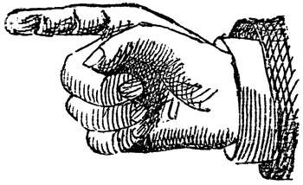
THE THREE COMPONENTS FORM THE TRIANGLE OF PROJECT MANAGEMENT CONSTRAINTS
What ?
How much?
SCOPE
COST
When ?
TIME

Slide 13
CONSTRAINT COMPONENTS ARE INTERCONNECTED AND INTERACT WITH EACH OTHER
SCOPE
SCOPE
BUDGET
BUDGET
DURATION
DURATION
A
B

Slide 14
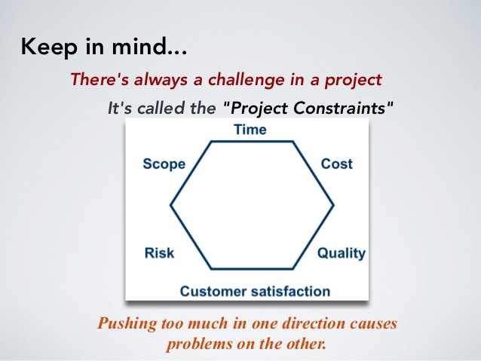
Sextuple Constrains
Resources

Slide 15
Business
Community
The project is aimed at solving clearly formulated problems
Society
Environment
Country

Slide 16
WHAT IS PROJECT MANAGEMENT ?

Slide 17
Project Management Definition
Project Management is “the application of knowledge, skills, tools and techniques to project activities to meet the Project Requirements .”

Slide 18
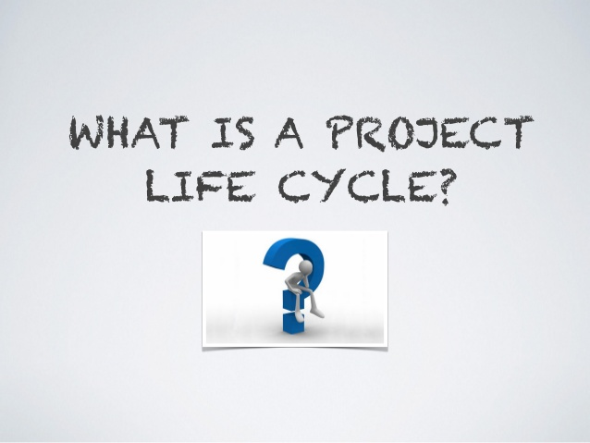

Slide 19






Human Life Cycle
Birth
Boyhood
Adulthood
Childhood
Death
Old age

Slide 20
Project Life Cycle
A project Life Cycle is the series of phases that a project passes through from its initiation to its closure.

Slide 21
Project Life Cycle
The phases are generally sequential, and their names and numbers are determined by the management and control needs of the organization or organizations involved in the project, the nature of the project itself, and its area of application.

Slide 22
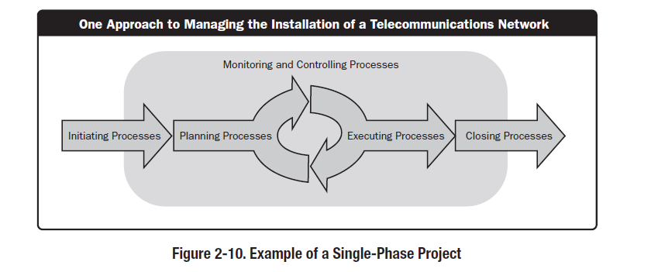

Slide 25
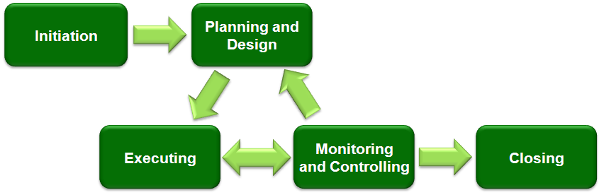
Typical development phases of an engineering project

Slide 26
Projects vary in size and complexity. All projects can be mapped to the following generic life cycle structure:
• Starting the project,
• Organizing and preparing,
• Carrying out the project work, and
• Closing the project.

Slide 27
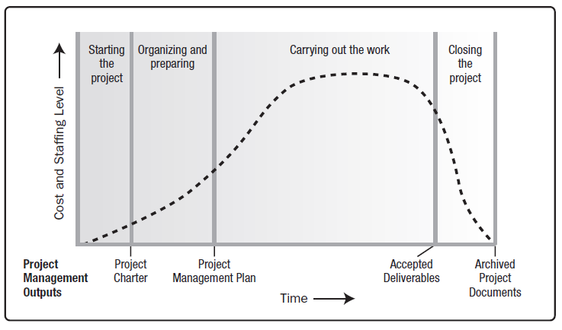
Typical Cost and Staffing Levels Across a Generic Project Life Cycle Structure

Slide 28

WHO IS
PROJECT MANAGER ?

Slide 29

IN FACT
PLANNED

Slide 30
Project managers accomplish work through the project team and other stakeholders.
Effective project managers require a balance of ethical, interpersonal, and conceptual skills that help them analyze situations and interact appropriately.

Slide 31
KNOWLEDGE
SKILLS

Slide 32
Basic Skills of a Project Manager
Negotiation
Communication
Leadership
Administration
Risk management

Slide 33
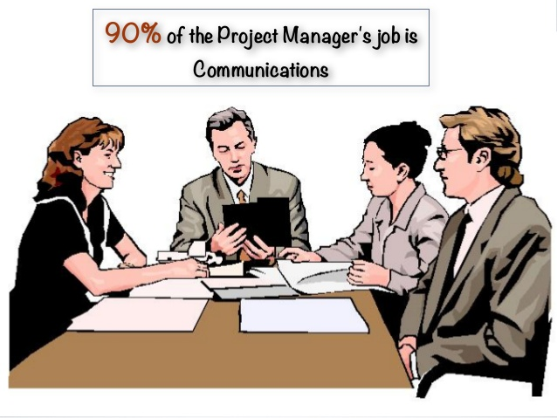

Slide 34


Communication Skills
Verbal Communication
Written Communication

Slide 35



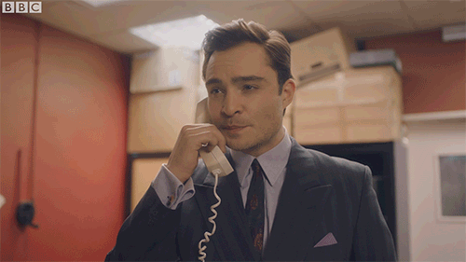
Verbal Communication Skills
Team Meetings
Project Presentation
Conversations with Stakeholders
Phone Conversations

Slide 36


Written Communication
Development of Meetings’ Minutes,
Email Correspondence,
Data periodic updating to present it to project beneficiaries.

Slide 37

Administrative Skills
Time planning
Distribution of work
Monitoring of work performance

Slide 38
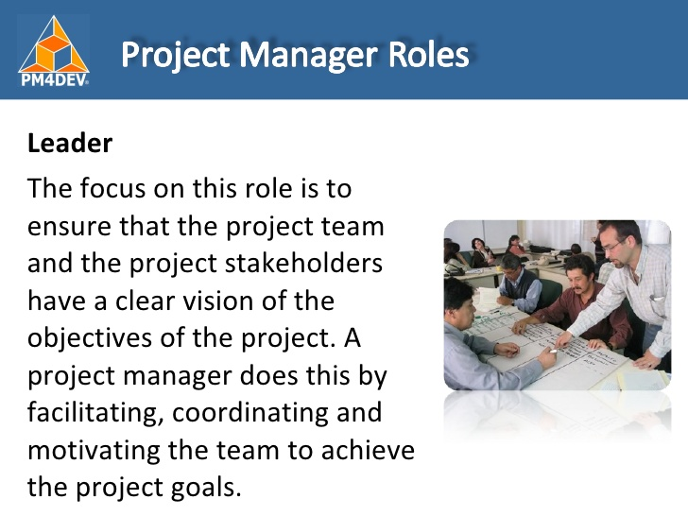
Project Manager Role as a Leader

Slide 39


Who are stakeholders ?

Slide 40

Stakeholders or interested parties of a project are those persons or organizations that are directly or indirectly related to the project.

Slide 41
Project Stakeholders
Stakeholders include all members of the project team as well as all interested entities that are internal or external to the organization.

Slide 42
Project Manager
Project Team
Subcontractor
Society
Stakeholders
Customer
State Agency
Internal and External Experts
Donor

Slide 43
Project Stakeholders can have a positive or negative impact on the project.
PROJECT

Slide 44
The project team identifies internal and external, positive and negative, and performing and advising stakeholders in order to determine the project requirements and the expectations of all parties involved.
The project manager should manage the influences of these various stakeholders in relation to the project requirements to ensure a successful outcome.

Slide 45
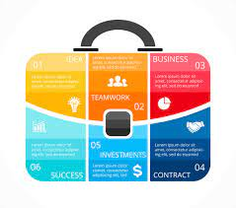
Portfolio of COMPANY / organization

Slide 46




Achieving a company or organization's strategic goal may require the implementation of several projects.
Strategic Goal
2
3
1

Slide 47
In this case, the company maps all its projects and includes them in a folder called a portfolio.
PORTFOLIO OF COMPANY
3
1
2

Slide 48
External Projects
Internal Projects
Grants or Sponsor Funds
Own Resources
aimed at improving the company's organizational capabilities or performance
Website update
Office makeover

Slide 49
As a result of project mapping, it can be revealed that the company or organization has in its portfolio:
a large number of internal but not enough external projects
internal or external projects that do not meet the goals set by the company's strategy
very few projects that are aimed to the company internal development

Slide 50

The company's management body (administrative body) performs portfolio management.
Portfolio management is an effective tool for strategic management of the company.

Slide 51

The goal of portfolio management is to ensure the goal defined by the company's strategy with the optimal use of resources.

Slide 52

One of the important tasks of project portfolio management is the determination of the priority of the included projects.
2
1
3

Slide 53

If the projects included in the portfolio do not correspond to the company's strategic goal, it can be concluded that the company's resources are used inefficiently.

Slide 54
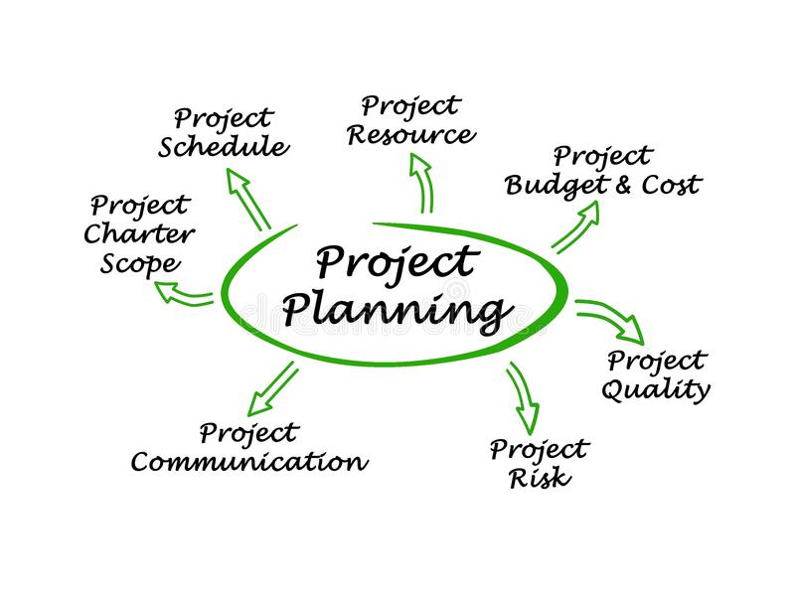
HOW THE PROJECT CAN BE PLANNED ?

Slide 55
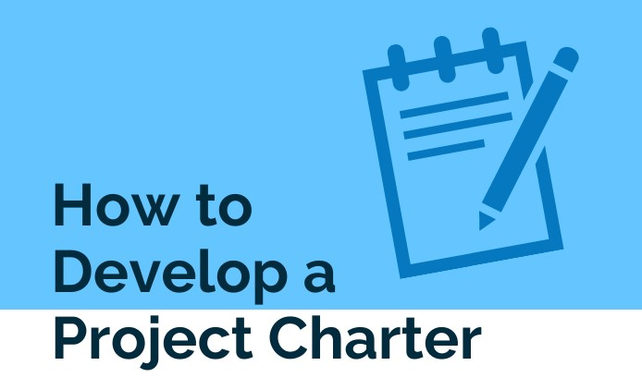

Slide 56
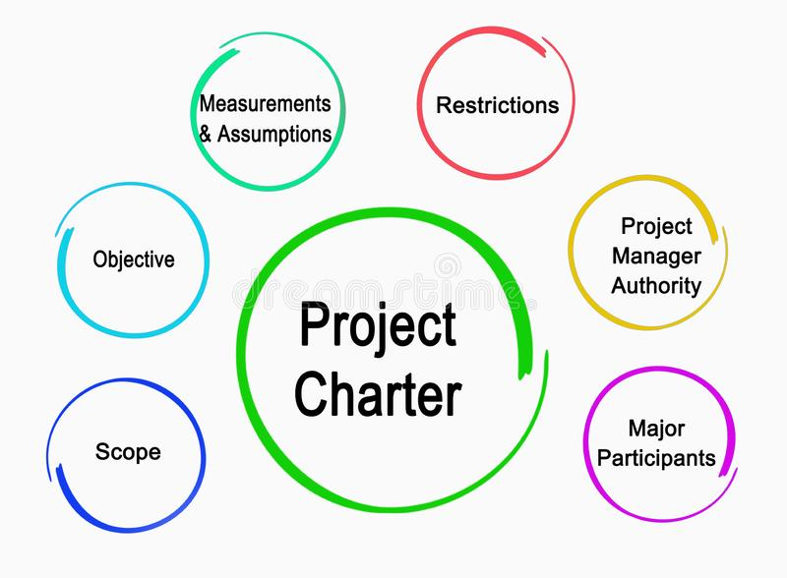
SRUCTURE OF PROJECT CHARTER

Slide 57


