Slide 1



Course: Project Management for Architects
Introduction
Master Degree level
ETCS: 2 Credits
Instructor Information
Instructor: Ms. Irina Vanyan, PhD in Economics, Associate Professor
E-mail: irinavanyan@gmail.com

Slide 2

Who Am I ? – 5 min
Irina Vanyan
Holder of PhD in Economics, Associate Professor
Instructor/Expert/ Advisor (up to 25 years experience)
Project Manager/Executive Director
Narrow Profile – Urban Economics
Managed over 120 projects (since 1994)
Author of “Project Management” Textbook

Slide 3

My Questions…
What have you heard about Project Management?
Have you any idea about Project Scope?
Have you managed project(s)?
What would you like to know?

Slide 4

The Plan for Today and for the future
Brief Introduction of Course
Learning Outcomes
Course Methodology
The main Policies
Key Definitions
What’s next?

Slide 5
Course brief description
how projects are defined
how projects are evaluated
This Course offers insight into
how projects are translated into requirements and deliverables

Slide 6

By learning how to identify stakeholder needs and convert those needs into viable, measurable project scope documentation
A project manager can successfully manage a project scope
A project manager can make informed recommendations when trade-offs between project scope, cost, and schedule become necessary

Slide 7
Textbook & Materials
[1] A Guide to the Project Management Body of Knowledge (PMBOK® Guide Fifth Edition): Project Requirements and Defining Scope, 2013
[2] A Guide to the Project Management Body of Knowledge (PMBOK® Guide Fifth Edition): Monitoring and Controlling Project Scope , 2013
[3] Vanyan, I. ”Project Management”. Educational Textbook, Yerevan, Republic of Armenia, 2014, Chapter 6, p.90-103
[4] Project Management Book. http://www.hraconsulting-ltd.co.uk/project-management-book-0101.htm
[5] Project Phases. http://www.hyperthot.com/pm_fazes.htm
[6] The Project Life Circle. http://www.visitask.com/project-life-cycle.asp
[7] Project Management Kit. http://www.method123.com/project-management-kit.php?AID=066976
[8] Christensen, E. “How to Create a Work Breakdown Structure and Why You Should”. https://www.lucidchart.com/blog/how-to-create-a-work-breakdown-structure-and-why-you-should

Slide 8
Course Structure
30 hours – classroom work:
50% - lectures by slide show; 50%- case studies analysis, discussions, exercises, testing.
60 hours – students’ individual work: self- preparatory work, home work execution.

Slide 9
Students Learning Outcomes
After course successful ending, students will be able:
to present the fundamental knowledge in the field of project scope management,
to understand the definition of project scope,
to understand the scope management processes, particularly: plan scope management, collect requirements, define scope, create work breakdown structure (WBS), validate scope, control scope.
to present the contemporary approaches in project scope management,
to apply the main principles of scope management to practical situation,
to discuss the different case studies regarding the field of project scope management,
to communicate with the stakeholders of the project with the purpose to identify their needs to define the scope of the project,
to exercise the skills in the field of WBS creation,
to demonstrate the capacity to control the project scope to give recommendations when trade-offs between project scope, cost, and schedule become necessary .

Slide 10
How Students will meet the Objectives ?
Course Methodology
Through a combination of the following activities in this course:
attending the classroom lectures,
participation in class discussions, games, exercises,
analysis of case studies to provide some solutions,
testing,
execution the home works as a part of individual work,
final examination.

Slide 11
Assessment Policy
Final Examination: a final examination test passing is a mandatory.
Every student has to attend the final exam.
Final exam will include all materials studied in the whole course.

Slide 12
Scale applied for Test Assessment
Criteria | Assessment
99-100% of the test’s Questions are answered perfectly | 20 points
95-98% of the test’s Questions are answered perfectly | 19 points
90-94% of the test’s Questions are answered perfectly | 18 points
80-89% of the test’s Questions are answered perfectly | 17 points
70-79% of the test’s Questions are answered perfectly | 16 points
60-69% of the test’s Questions are answered perfectly | 15 points
50-59% of the test’s Questions are answered perfectly | 14 points
40-49% of the test’s Questions are answered perfectly | 13 points
30-39% of the test’s Questions are answered perfectly | 12 points
20-29% of the test’s Questions are answered perfectly | 11 points
10-19% of the test’s Questions are answered perfectly | 10 points
Less than 10% of the test’s Questions are answered perfectly | failure

Slide 13
Course Policies
Attend Class
E-mail contact with Instructor
  Electronic devices
  Food and drinks
  Punctuality, Attendance and Talking
  Academic Honesty

Slide 14

1. Attend Class
Students are expected to attend all class sessions as listed on the course calendar.

Slide 15

2. E-mail contact with Instructor
The best way to contact Instructor outside of the class hours is via email.
For any email correspondence with instructor, the subject line has to be completed in appropriate way.
An email to instructor is not a text message to one of a student’s friends. That is why the standard form, grammar, punctuation, spelling, etc. have to be adhered by students.

Slide 16
A. Template for e-mail to Professor
Hi,
How are you?
Unfortunately I cannot find you at the university.
How I can see you ? I need some literature/internet sources about the topic ……………….
………………….(Name)

Slide 17
B. Template for e-mail to Professor
Dear Dr. …………….(Professor),
I would appreciate the chance to talk with you about ……………………..
I know you are very busy. However I need your advice. We could schedule an appointment or I can drop by your office hours on ……….(day) and at ………… (time).
Please let me know if there is any ………………..
I look forward to talking to you soon.
Best Regards,
………………….(Name)

Slide 18
C. Template for e-mail to Professor
My lovely Professor,
How are you?
Unfortunately I missed your last class.
How I can see you for additional consultation? I would like ask you the hard copies of your last lecture. I need some literature/internet sources about the topic ……………….
………………….(Name)

Slide 19

  3. Electronic devices
Laptops, iPad and cell phones type devices are permitted for note-taking and course related material only.
If some of them (laptops, iPads, etc.) is/are discovered as being used for non-classroom activities, it will not allow in the class.
Non-classroom activities include, but are not limited to, checking Facebook page, emailing, online banking, playing games, looking at websites, and watching anime, etc.

Slide 20

  3. Electronic devices – Cont’ed
Cell phones, noise makers, and anything that may disturb the class are to be turned oﬀ or silenced.
Use common sense and being respectful to the fellow classmates are required.
If these devices become a problem in class there will be a draconian policy implemented.
Any student’s noise maker that goes oﬀ in class automatically loses one-percentage point of their ﬁnal grade for each infraction.

Slide 21



  4. Food and drinks
Food eating in class room is prohibited strongly because it is distracting to instructor and other students.
Battled water, coffee, tea, soft drink, etc. are fine, but users have to be considerate and do not leave trash.
In case of spilling something it should be cleaned up by user.

Slide 22

5.Punctuality and Attendance
Students have to arrive to class on time.
If student miss class, it is solely his/her responsibility to obtain the notes and/or materials given from a classmate. Actions that have negative eﬀects on others will not be tolerated in the classroom.

Slide 23

5. Talking
Students have to refrain from talking with their neighbors during class. If any questions are raised, instructor has to be asked, but not the student sitting next. Talking in class is rude and distracting, both to instructor and to other students.

Slide 24
  6. Academic Honesty
Academic honesty is expected. In fairness to the many students who work hard and put in an honest eﬀort, those who in any way engage in acts of academic dishonesty or cheating will be treated most harshly as to do otherwise would devalue all honest student’s education.
Team discussions students of class material together (outside of class) are encouraged to help each other in solving problems and to understand the material.

Slide 25

10 minutes BREAK
for relax

Slide 26


History of Project Management
Some people argue that building the Egiptian pyramids was a project, as was building the Grate Wall of China (III century BC – before the birth of Christ till 1644).

Slide 27
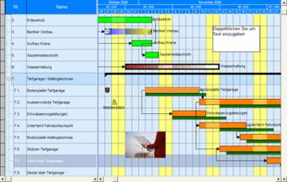
Gantt Chart (1910)
A Gantt Chart is a standard format for displaying project schedule information by listing projects activities and their corresponding start and finish dates in a calendar format.

Slide 28
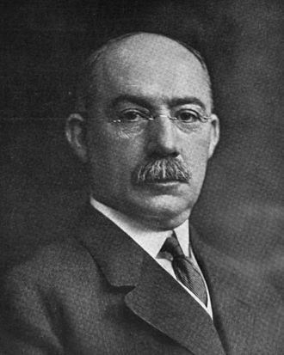
Gantt Chart (1910)
The chart is named after Henry Gantt, who designed his chart around the years 1910–1915.
Henry Laurence Gantt, (1861 – 1919) was an American mechanical engineer and management consultant who is best known for his work in the development of scientific management. He created the Gantt chart in the 1910s.

Slide 29
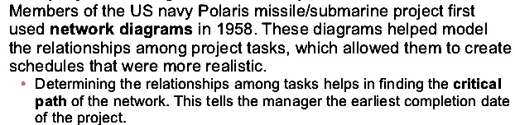
History of Project Management
The military was the key industry behind the development of several project management techniques.

Slide 30
Project Management Institut (PMI)
The Project Management Institute (PMI) was founded in Pennsylvania in 1969 by five volunteers in the field of project management working together to “advance the practice, science and profession of project management”.

Slide 31
What is PMBOK® Guide ?
PMBOK® Guide is an acronym for “A Guide to the Project Management Body of Knowledge”.
It is the single most important publication by the PMI for PMP® aspirants to study and prepare for the PMP® Exam.

Slide 32
What is PMBOK® Guide ?
A Guide to the Project Management Body of Knowledge (PMBOK® Guide) is a publication by the Project Management Institute (PMI) which documents the standards and best practices for the field of project management.

Slide 33
Project Management Body of Knowledge Guide (PMBOK® Guide )
The first ever PMBOK® Guide was published in 1996.
Each subsequent edition was introduced to supersede the previous version as new best practices and standards are continually introduced and the organization of the PMBOK® Guide becomes more systematic.
The current edition of the PMBOK® Guide is the fifth edition. The 6th edition of the PMBOK® Guide will be published in September 2017 as review and editorial work is now in progress.

Slide 34
A few project management methodologies examples with short descriptions:
PRojects IN Controlled Environments (PRINCE) is a project management method. It covers the management, control and organization of a project.
Method 123 Project Management methodology, also called MPMM (Project Management Methodology Manager) is based on the worldwide project management standards PMBOK and Prince2 and contains all of the project management templates, forms and checklists needed.
Ten Step Project Management Process is a methodology for managing work as a project and it’s designed to be as flexible as you need to manage your project.
UPMM Unified Project Management methodology based on suite of knowledge management tools.
AdPM – a best practices project methodology.
MBP- Managing by Project from X-Pert Group. Programme and Project Management methodology and services.
MITP – Managing Information Technology Projects. IBM’s established project management delivery method.
Microsoft Solutions Framework (MSF) is a set of principles, models, disciplines, concepts, and guidelines for delivering information technology solutions.

Slide 35

DO YOU THINK YOU CAN MANAGE A PROJECT ???

Slide 36


20 minutes
for HAPPY WORK:
“TOWER BUILDING”

Slide 37

“TOWER BUILDERS”
This icebreaker exercise requires 20 minutes for preparation.
The aim is to build a tower to support a box with candy.
Class is devided to four groups.

Slide 38

“TOWER BUILDERS”
The group that builds the highest tower that successfully supports a box for 10 seconds wins.

Slide 39
Questions to “Tower Building” Game
Can the “Tower Building” be called a project?
If yes:
Who is a Customer?
Who is a beneficiary?
Who is a stakeholder?
What resources have been used for the project?
What is an Outcome of the project?
What kind of constrains did you have?

Slide 40
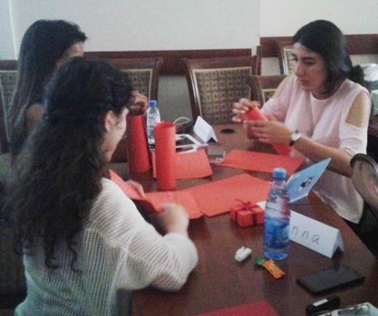
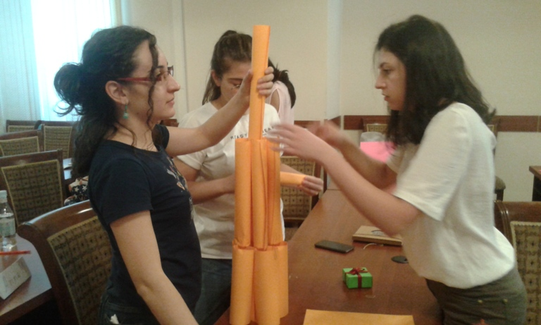
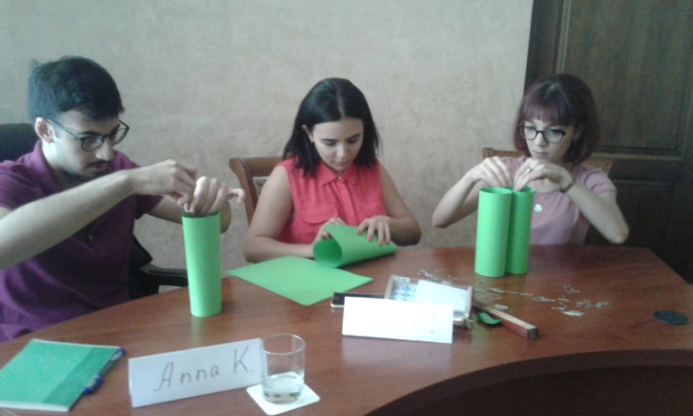
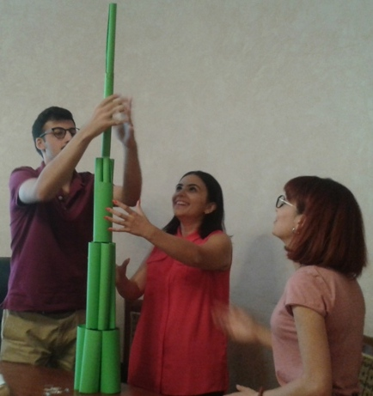
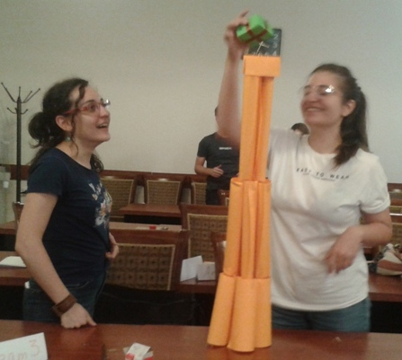
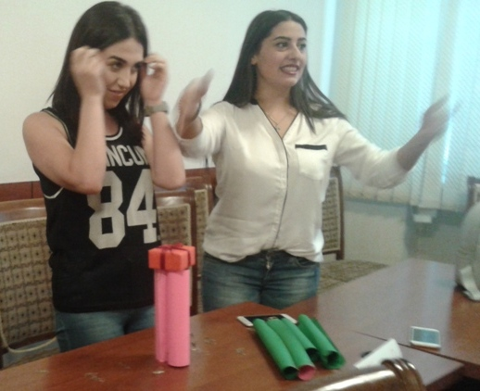
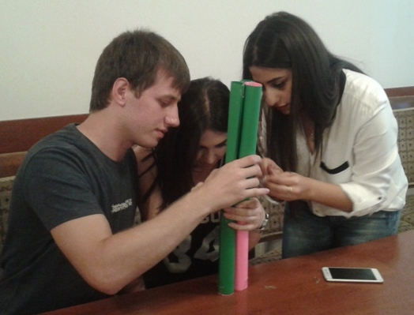
“TOWER BUILDERS”

Slide 41


let's earn some artificial coins
against your knowledge !!!

Slide 42
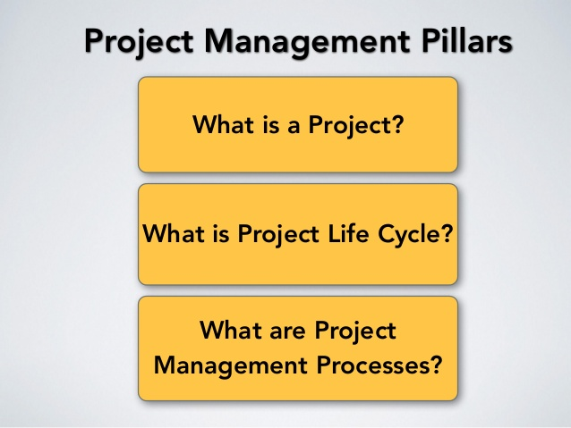

Slide 43


Slide 44
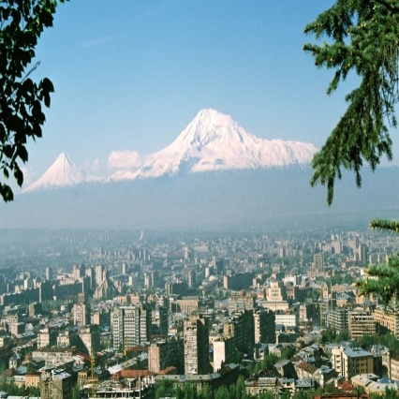
What is a Project ?
Unique endeavor
To achieve specific goal/objective
Having a defined beginning and end date
Governed by a budget, scope and time

Slide 45


Project Definition by PMBOK® Guide

Slide 46
Temporary nature of Project
The temporary nature of projects indicates that a project has a definite beginning and end.
The end is reached when the project’s objectives have been achieved or when the project is terminated because its objectives will not or cannot be met, or when the need for the project no longer exists.

Slide 47
Every project creates a unique product, service, or result.
The outcome of the project may be tangible or intangible.

Slide 48

QUIZ !!!
What is a Project ?
What Project Attribute do you know ?

Slide 49
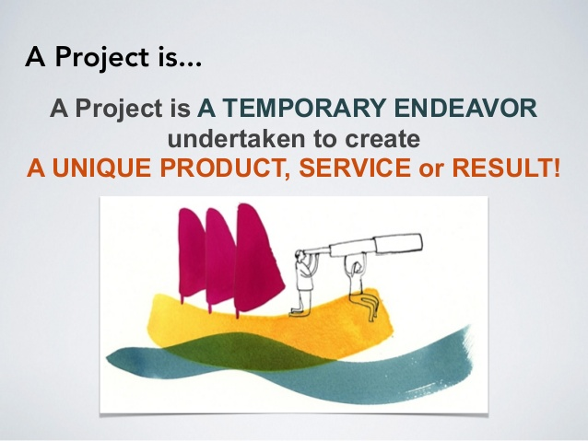

Slide 50

VARIOUS STAGES OF PROJECT
A PATH FOR SUCCESSFUL COMPLETION
STATUS UPDAYTING THROUGH
NETWORK AND GIVING EARLY WORNING
DATA COLLECTION
PLANNING & SCHEDULING
THINKING

Slide 51
WHAT IS PROJECT MANAGEMENT ?

Slide 52
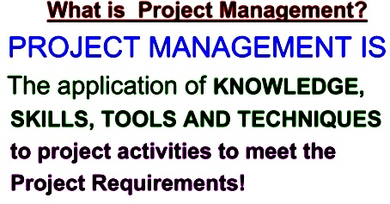

Slide 53
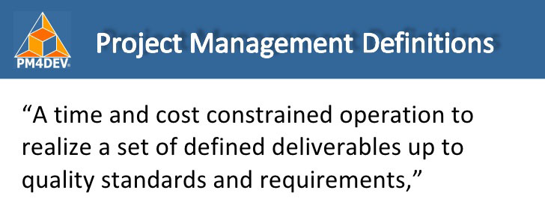
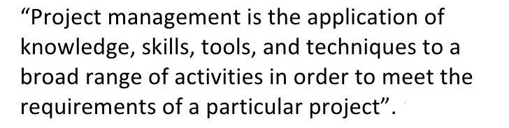
(International Project Management Association)
(Project Management Institute)

Slide 54
10 min
LET’S MAKE A PAZZLE !!!
What is Project Management?
Give some definition ......

Slide 55
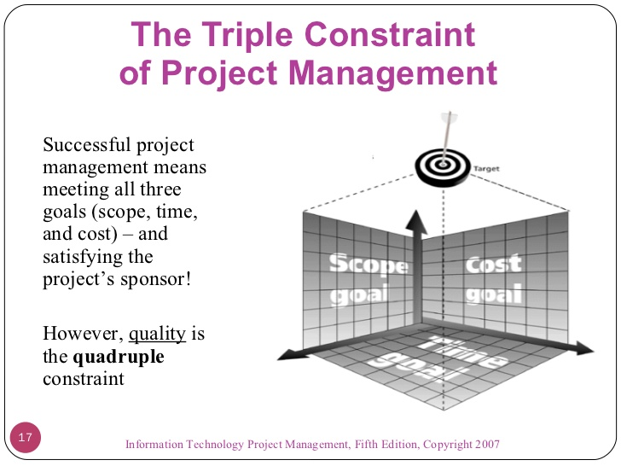

Slide 56
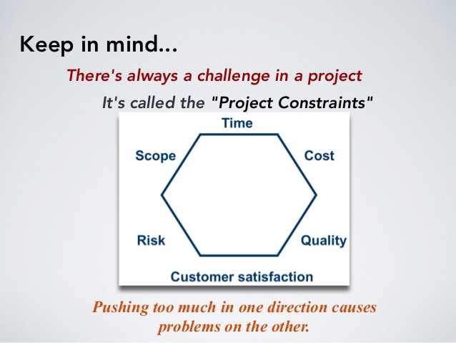
Sextuple Constrains
Resources

Slide 57
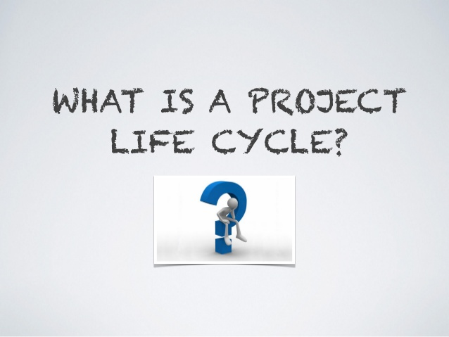
WHAT IS
A PROCESS GROUP ?

Slide 58
Project management is the application of knowledge, skills, tools, and techniques to project activities to meet the project requirements.

Slide 59
A process is a set of interrelated actions and activities performed to create a pre-specified product, service, or result.
Each process is characterized by its inputs, the tools and techniques that can be applied, and the resulting
outputs.

Slide 60
The PMBOK® Guide describes the nature of project management processes in terms of the integration between the processes, their interactions, and the purposes they serve.
Project management processes are grouped into five categories known as Project Management Process Groups (or Process Groups):

Slide 61
Project management is accomplished through the appropriate application and integration of the 47 logically grouped project management processes, which are categorized into five Process Groups.

Slide 62
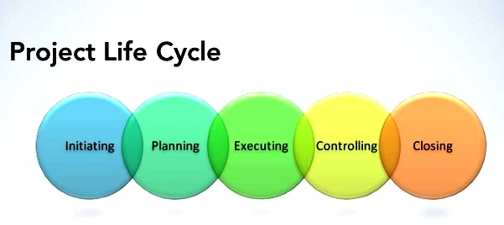
These five Process Groups are:

Slide 63
Process Groups
Initiating Process Group. Those processes performed to define a new project or a new phase of an
existing project by obtaining authorization to start the project or phase.
• Planning Process Group. Those processes required to establish the scope of the project, refine the
objectives, and define the course of action required to attain the objectives that the project was undertaken
to achieve.

Slide 64
Process Groups
• Executing Process Group. Those processes performed to complete the work defined in the project management plan to satisfy the project specifications.
• Monitoring and Controlling Process Group. Those processes required to track, review, and regulate the
progress and performance of the project.
• C losing Process Group. Those processes performed to finalize all activities across all Process Groups to
formally close the project or phase.

Slide 65

Make a Color Chain
Of Process Groups in 15 minutes
Assessment Criteria:
a/The chain has to be developed in required time.
b/The chain has to be as long as possible.
c/ The sequence of processes has to be right.

Slide 66
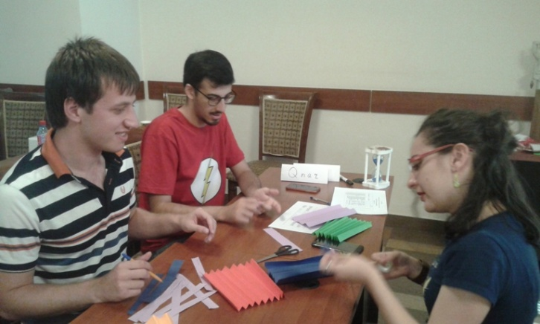
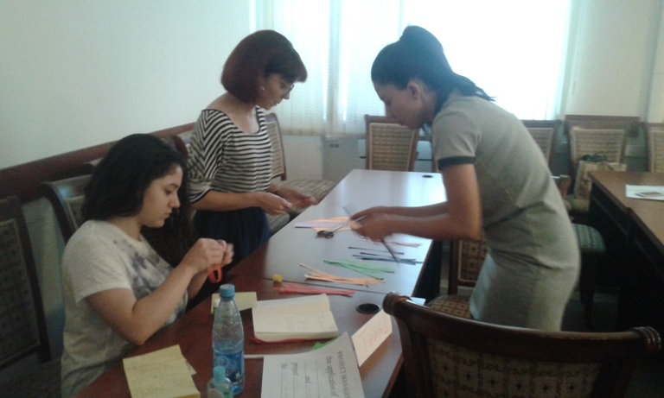
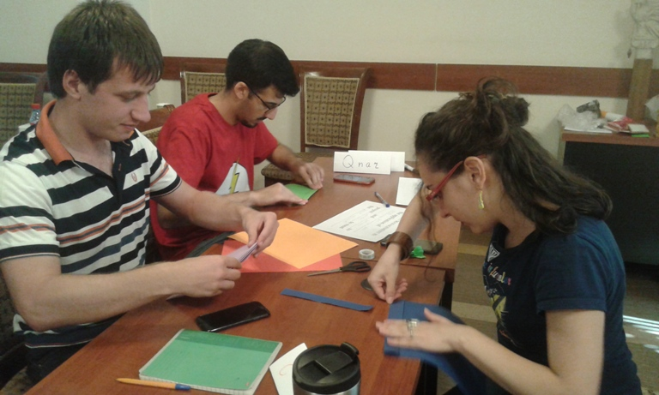
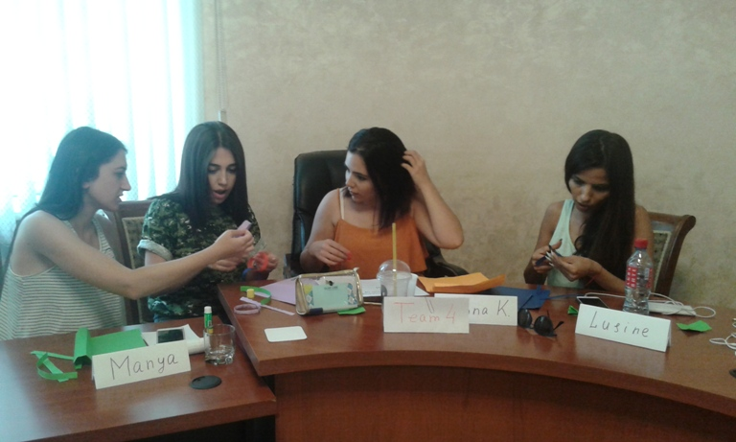
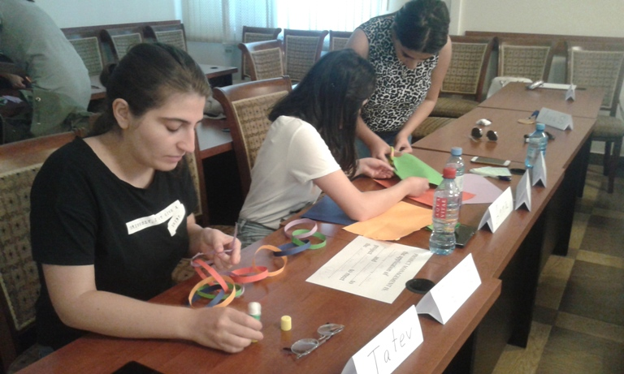
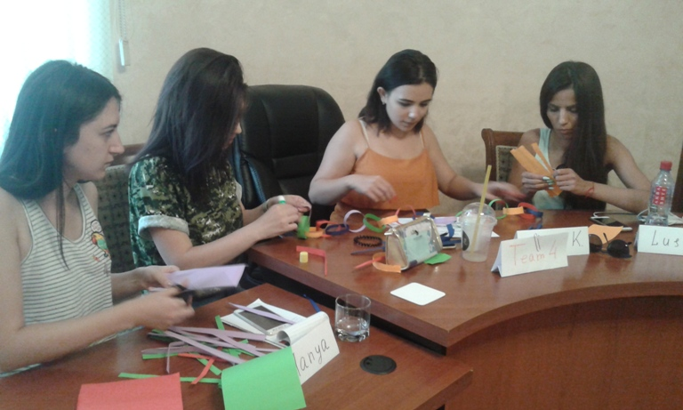
“Color Chain” Developers

Slide 67
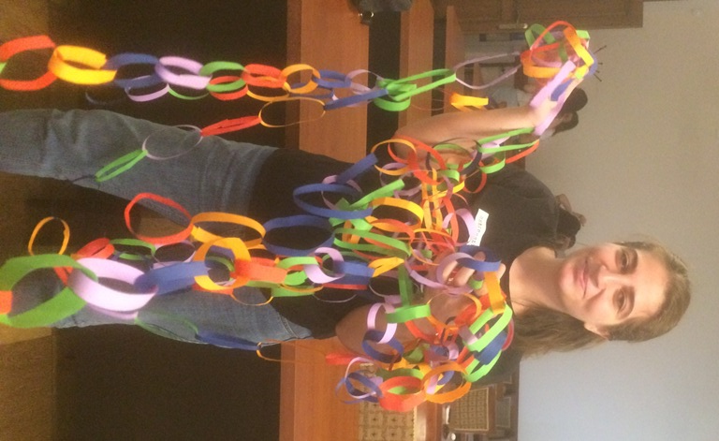
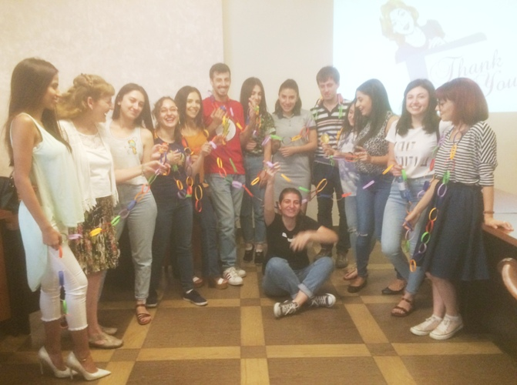
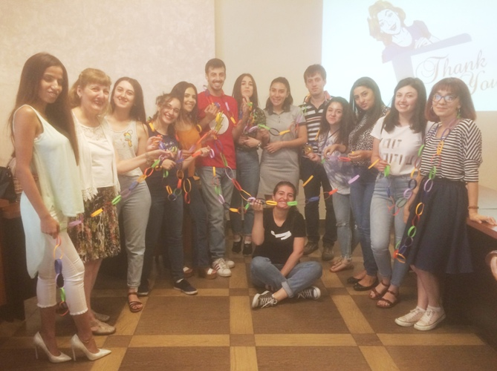
“Color Chain” Developers

Slide 69
Project Life Cycle
A project life cycle is the series of phases that a project passes through from its initiation to its closure.

Slide 70
Project Life Cycle
The phases are generally sequential, and their names and numbers are determined by the management and control needs of the organization or organizations involved in the project, the nature of the project itself, and its area of application.

Slide 71
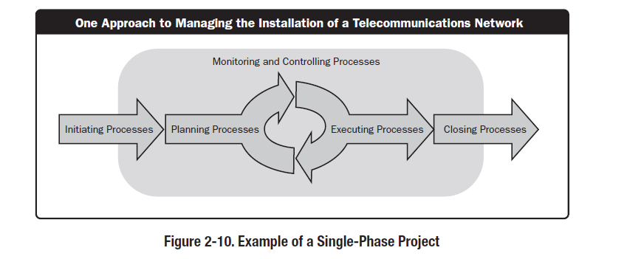

Slide 74
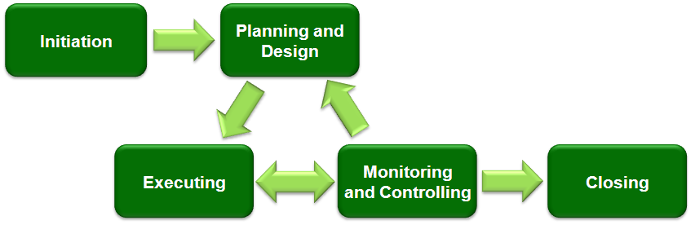
Typical development phases of an engineering project

Slide 75
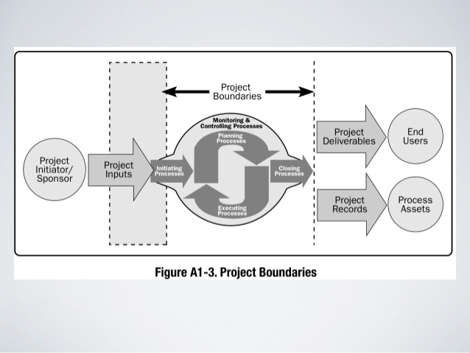

Slide 76
Projects vary in size and complexity. All projects can be mapped to the following generic life cycle structure:
• Starting the project,
• Organizing and preparing,
• Carrying out the project work, and
• Closing the project.

Slide 77
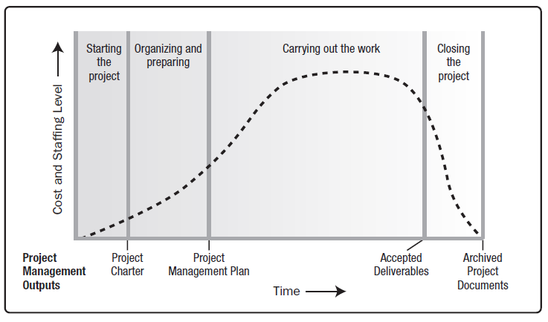
Figure 2-8. Typical Cost and Staffing Levels Across a Generic Project Life Cycle Structure

Slide 78

WHO IS
PROJECT MANAGER ?

Slide 79
Project managers accomplish work through the project team and other stakeholders.
Effective project managers require a balance of ethical, interpersonal, and conceptual skills that help them analyze situations and interact appropriately.

Slide 80
Interpersonal Skills of a Project Manager
Leadership,
• Team building,
• Motivation,
• Communication,
• Influencing,
• Decision making,
• Political and cultural awareness,
• Negotiation,
• Trust building,
• Conflict management, and
• Coaching.

Slide 81
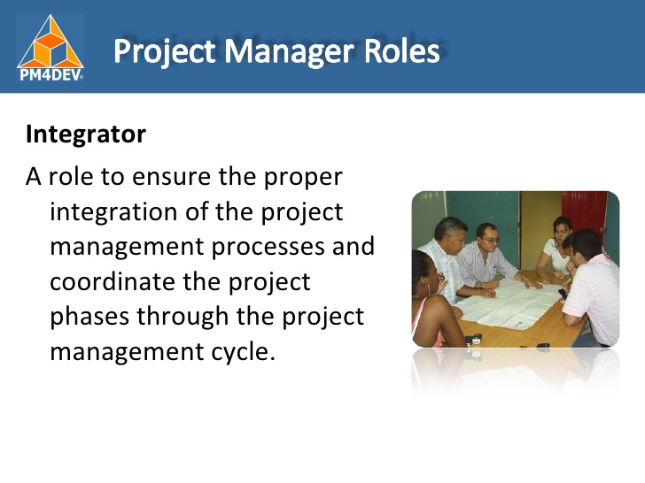

Slide 82
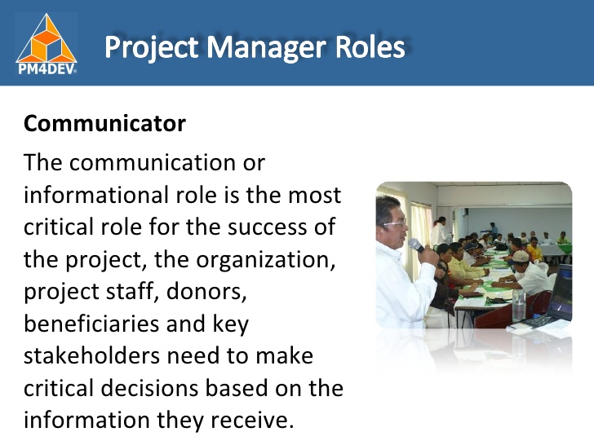

Slide 83
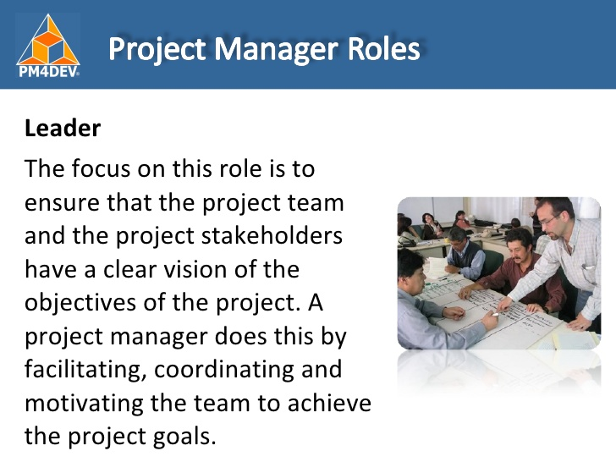

Slide 84
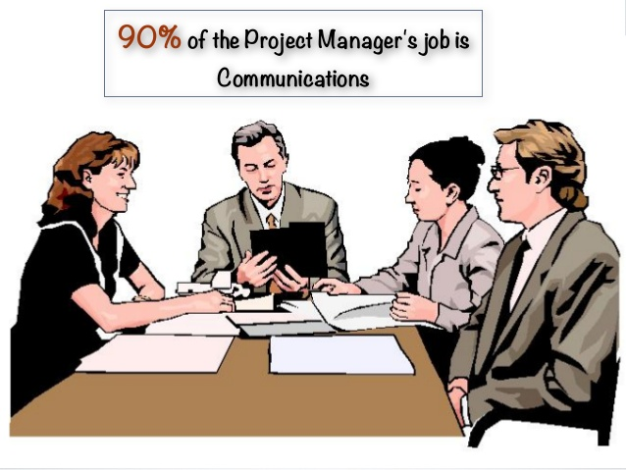

Slide 85
15 minutes
for HAPPY WORK:
PROJECT FABULOUS FLAG DEVELOPMENT….

Slide 86

MY FABULOUS FLAG FOR PROJECT MANAGER….

Slide 87
Project Stakeholders
Stakeholders include all members of the project team as well as all interested entities that are internal or external to the organization.

Slide 88
The project team identifies internal and external, positive and negative, and performing and advising stakeholders in order to determine the project requirements and the expectations of all parties involved.
The project manager should manage the influences of these various stakeholders in relation to the project requirements to ensure a successful outcome.

Slide 89
let's earn some artificial coins
against your knowledge !!!

Slide 90
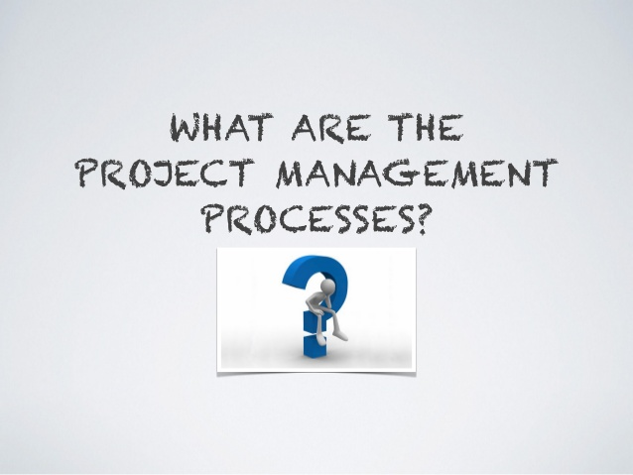
WHAT ARE THE KNOWLEDGE AREAS ?

Slide 91

REMINDER !!!
47 Processes
5 Process Groups
10 Knowledge Areas

Slide 92
The 47 project management processes identified in the PMBOK® Guide are further grouped into ten separate Knowledge Areas.
A Knowledge Area represents a complete set of concepts, terms, and activities that make up a professional field, project management field, or area of specialization.
These ten Knowledge Areas are used on most projects most of the time.

Slide 93
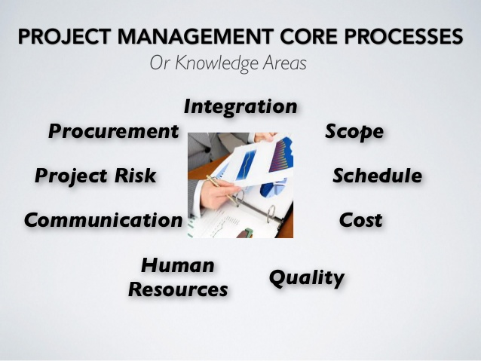
Knowledge Areas
Stakeholders

Slide 94
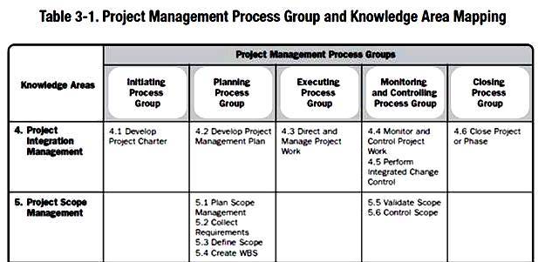

Slide 95
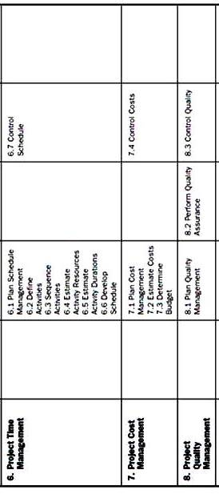

Slide 96
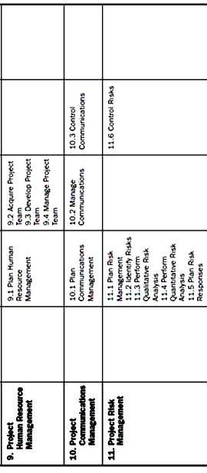

Slide 97
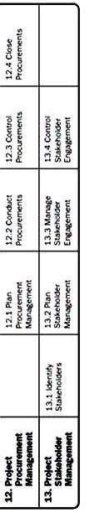

Slide 98
## | KNOWLEDGE AREAS OR PM POCESSES | PROJECT MANAGEMENT PROCESS GROUPS
 |  | Initiating Process Group | Planning Process Group | Executing Process Group | Monitoring and Controlling Process Group | Closing Process Group
 | 4. PROJECT INTEGRATION MANAGEMENT
1 | 4.1 Develop Project Charter | +
2 | 4.2 Develop Project Management Plan | +
3 | 4.3 Direct and Manage Project Work |  |  | +
4 | 4.4 Monitor and Control Project Work |  |  |  | +
5 | 4.5 Perform Integrated Change Control |  |  |  | +
6 | 4.6 Close Project or Phase |  |  |  |  | +

Slide 99
## | KNOWLEDGE AREAS OR PM POCESSES | PROJECT MANAGEMENT PROCESS GROUPS
 |  | Initiating Process Group | Planning Process Group | Executing Process Group | Monitoring and Controlling Process Group | Closing Process Group
 | 5. PROJECT SCOPE MANAGEMENT
6 | 5.1 Plan Scope Management |  | +
7 | 5.2 Collect Requirements |  | +
8 | 5.3 Define Scope |  | +
9 | 5.4 Create WBS |  | +
10 | 5.5 Validate Scope |  |  |  | +
11 | 5.6 Control Scope |  |  |  | +

Slide 100
The PMBOKR Guide defines the important aspects of each Knowledge Area and how it integrates with the five Process Groups.
As supporting elements, the Knowledge Areas provide a detailed description of the process inputs and outputs along with a descriptive explanation of tools and techniques most frequently used within the project management processes to produce each outcome.

Slide 101
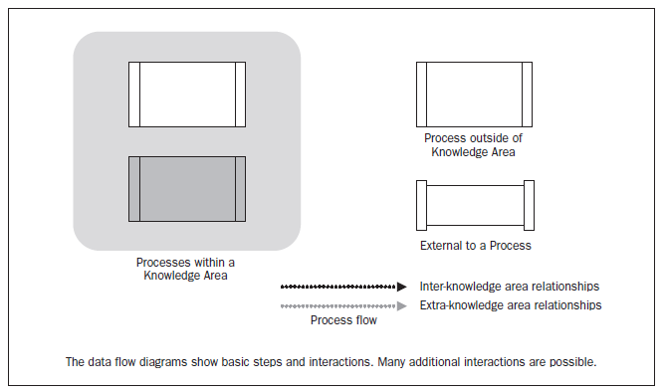
Figure 3-6. Data Flow Diagram Legend

Slide 102
What’s next ?

Slide 103
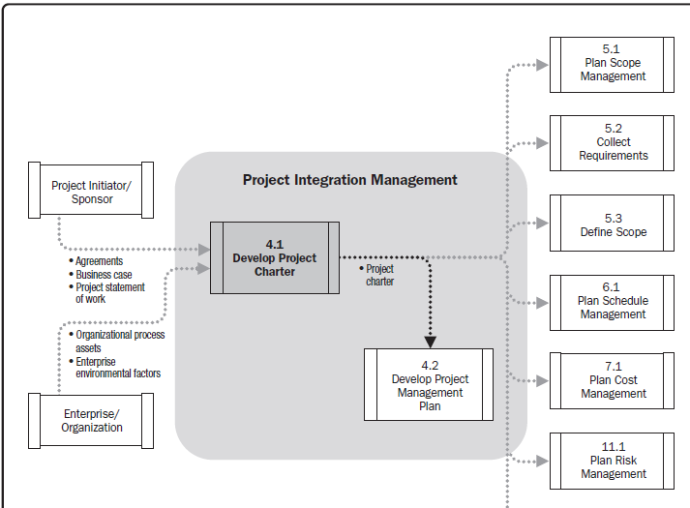

Slide 104
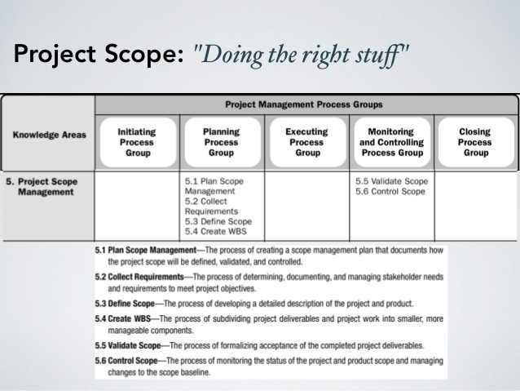

Slide 105


