Slide 1
2021

Slide 2
DOCENTES TALLER IACOBUS+ / ETSAC
CRISTÓBAL CRESPO / PROYECTOS
JUAN PRIETO
ANTONIO RAYA
ENRIQUE ANTELO ÁNGELES SANTOS PEPE VÁZQUEZ
JESÚS CONDE
ENRIQUE BLANCO
/ PROYECTOS
/ CONSTRUCCIÓN
/ CONSTRUCCIÓN
/ CONSTRUCCIÓN
/ ESTRUCTURAS
/ URBANISMO
/ COMPOSICIÓN
2021
DOCENTES WORKSHOP IACOBUS+ / ETSAC / ENSACF / OTH / NUACA
FELIPE PEÑA
CRISTÓBAL CRESPO JUAN PRIETO
/ ETSAC
/ ETSAC
/ ETSAC
YVON COTTIER
MATHILDE LAVENU LÖIS DE DINECHIN
AUDREY CARRARA
/ ENSACF
/ ENSACF
/ ENSACF
/ ENSACF
ANDREAS EMMINGER / OTH
ERIC FRISCH / OTH
AREV SAMUELYAN / NUACA
EMMA HARUTUNYAN / NUACA

Slide 3
EU-PROJECT 2017-1-ES01KA203-038344
The project IACOBUS + Culture, Heritage and Integration is an academic experience in an international university environment for students of architecture in the last period of their studies. It is built on a previous experience, the IACOBUS program, a collaboration agreement that implied around 1,000 students, teachers and experts from the University of A Coruña, the ENSA of Clermont-Ferrand and the OTH of Regensburg since 1995. The proposal is to work around a series of projects of awareness and intervention on heritage sites – and their surroundings – in risk or threat of disappearance by the lack of legal mechanisms of protection, abandonment, ruin or urban pressure. It is all about giving new uses to buildings and revitalizing their environments, as part of a collective exercise of architecture and research, with a high impact on the communities where it operates. During these years, those responsible established a rotating methodology, so that each semester the students work in a different site and in a different country.
During the period of 2018-2020, the following sites are subject to interventions by Iacobus+:
Iacobus+ 2018: Stadtlagerhaus, Regensburg (D), by OTH Regensburg
Iacobus+ 2019: Colegiata Sta. María la Real do Sar, Santiago de Compostela (ES), by UDC Iacobus+ 2020: San Lazzaro degli Armeni, Venice (I), by ENSACF / NUACA
The opportunity to incorporate a new institution to the project, the NUACA of Yerevan (Armenia), and the correspondence between the study plans – once adapted to the European Higher Education Area (EHEA) – of the OTH, ENSACF and ETSAC, speak in favor to update the project under a more ambitious schemes. In this way, by the year 2020, the following actions shall be pursued:
1º The incorporation of new associated institutions with coincident objectives.
2º The positioning of the project as a disciplinary axis, around the architectural rehabilitation, in the Master in Architecture in the study plans of the OTH, ENSACF and ETSAC.
3º The establishment of double degrees with a Master level among the participating institutions.
4. Involve all the actors in the project in a global problem such as the situation of refugees, displaced persons and asylum seekers, through the commitment of the students in the projects within the host communities.
The project has a triple purpose:
– To provide specialized training for students in a context of collective work, joining international groups, under real premises and hypotheses, so that their work, far beyond the academic, will have a significant social impact. For students, this is an opportunity for training in the field of heritage intervention, but also an experience of exchange of knowledge and methodologies in work and training.
– To invite citizens and authorities to reflect on the cultural value and the possibilities of providing new uses to old industrial, educational, religious, civil, etc. facilities, understanding the recovery of these buildings as a cultural value, with commitment to sustainability and social responsibility towards less favored communities.
– Contribute to the construction of the European citizenship by raising awareness towards our common history and cultural heritage.

Slide 4
V
1995 / 2020

Slide 5
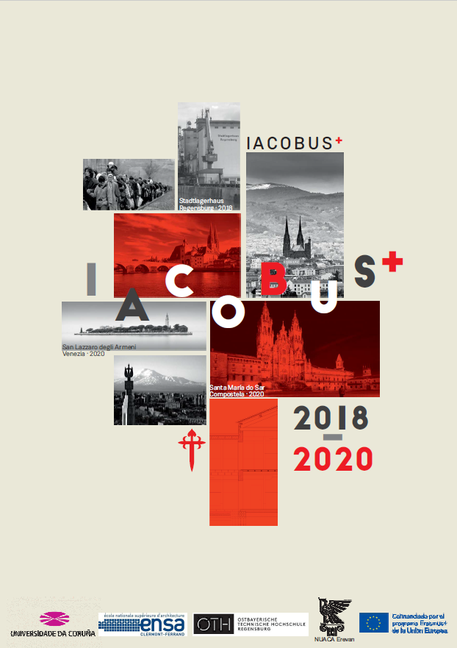
2 1

Slide 6
1 8

Slide 7
1 9

Slide 8
2 0

Slide 9
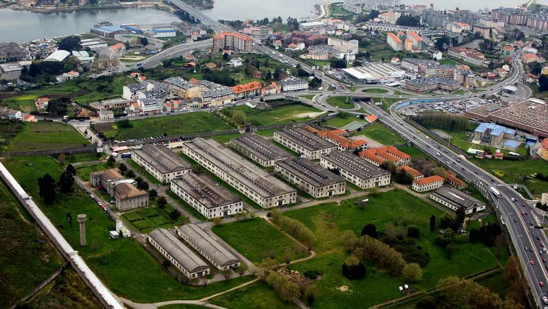
2 1

Slide 10
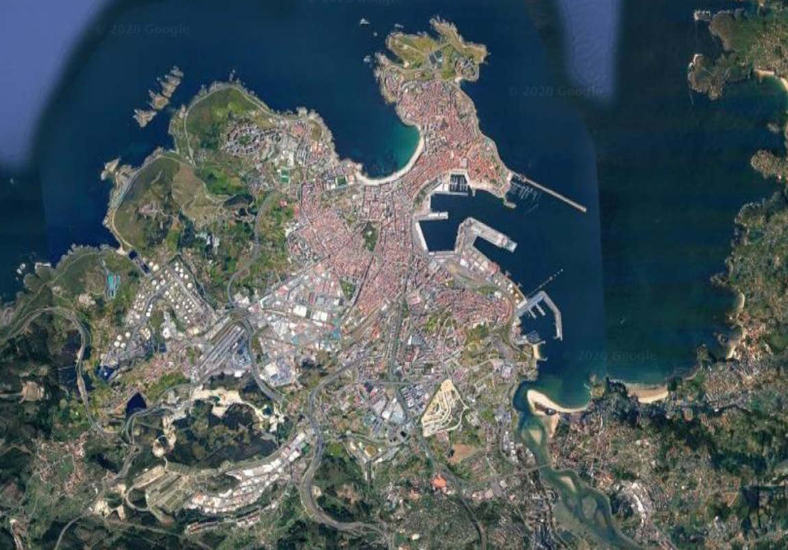
2 1

Slide 11
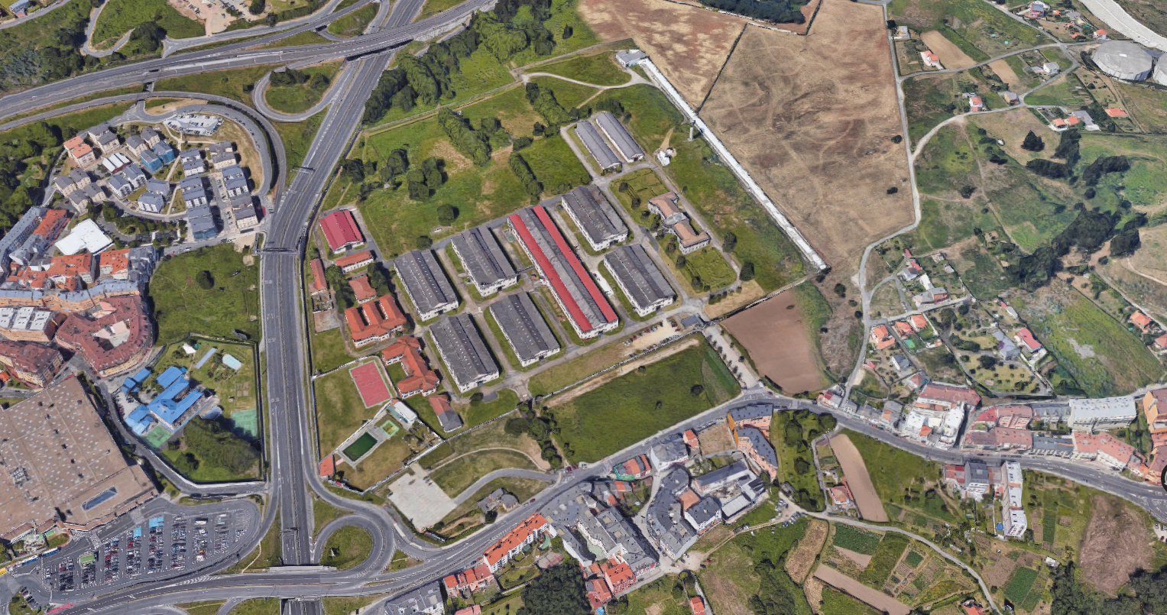
2 1

Slide 12
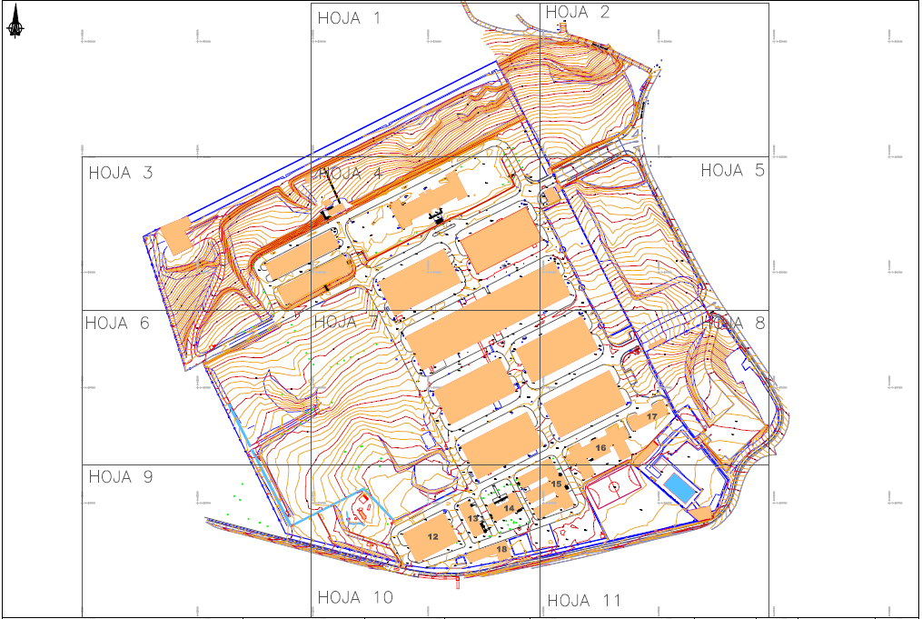
2 1

Slide 13
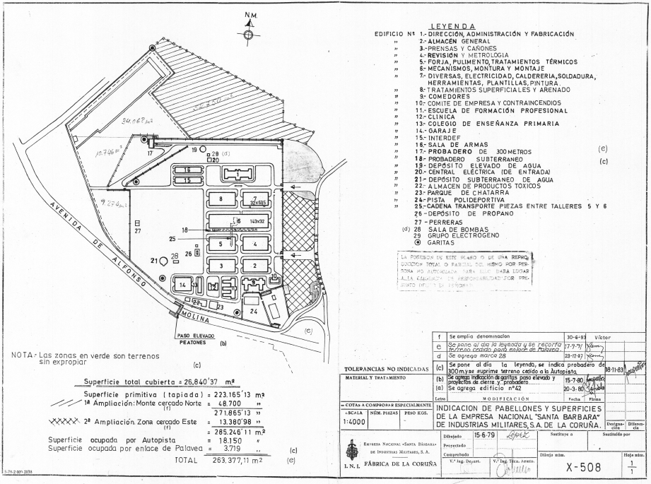
2 1

Slide 14
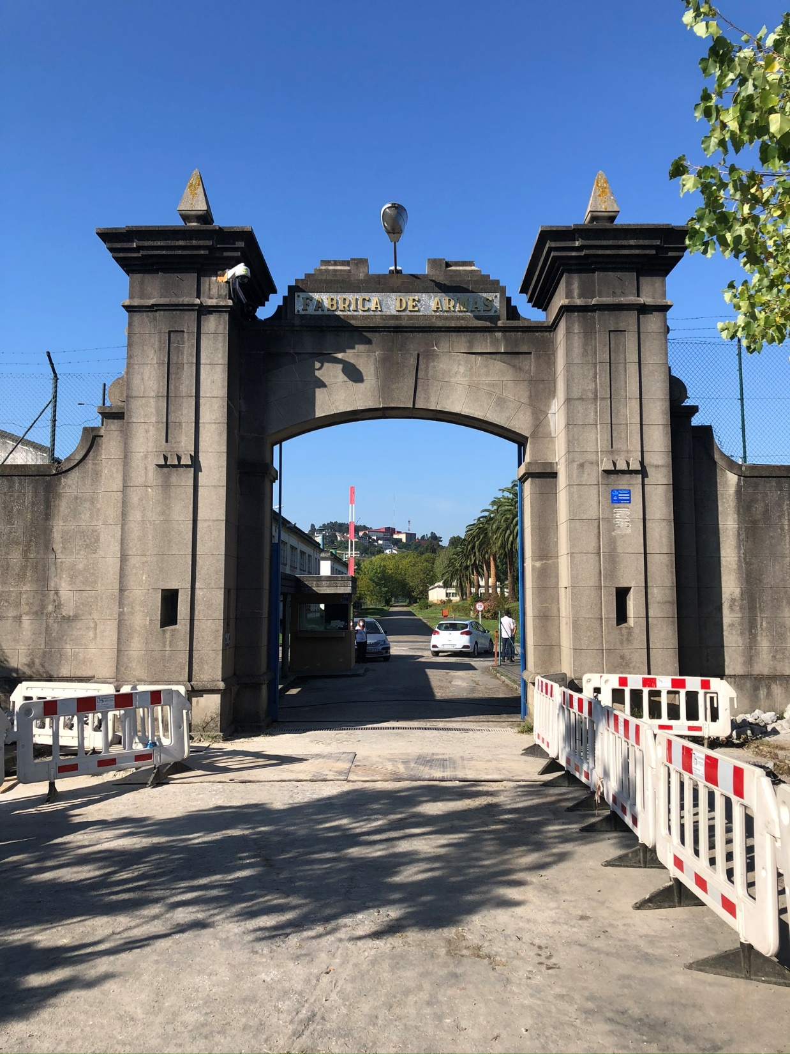
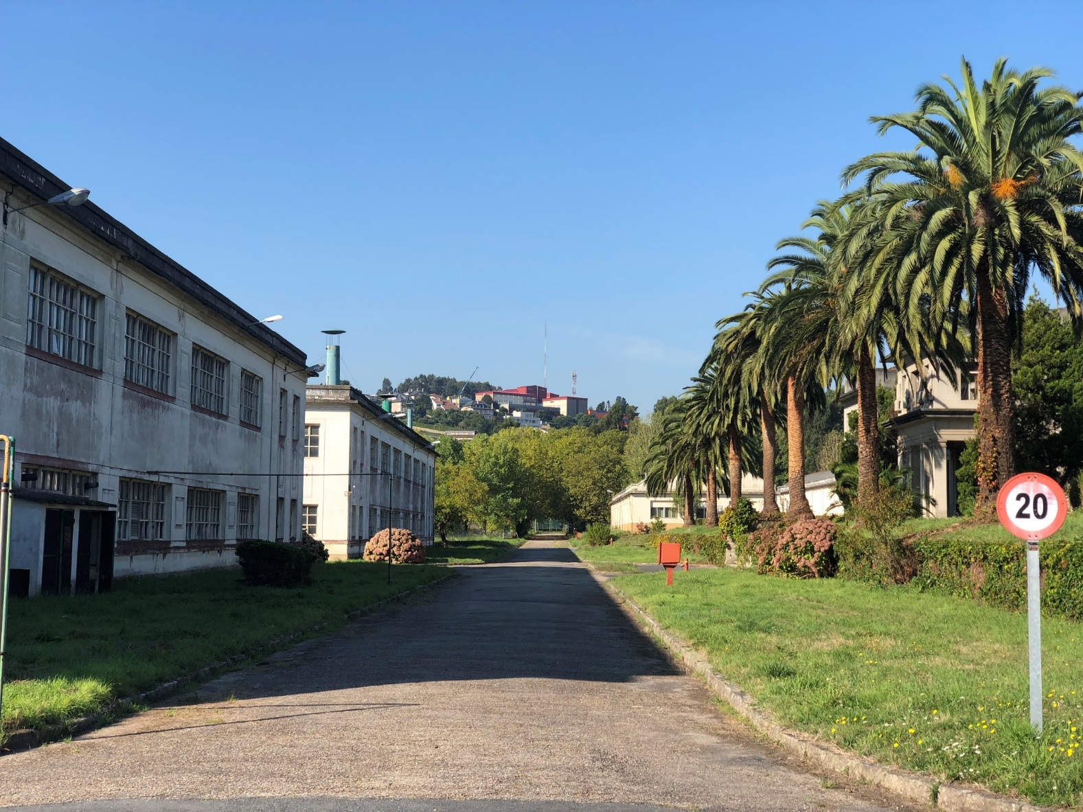
2 1

Slide 15
2 1

Slide 16
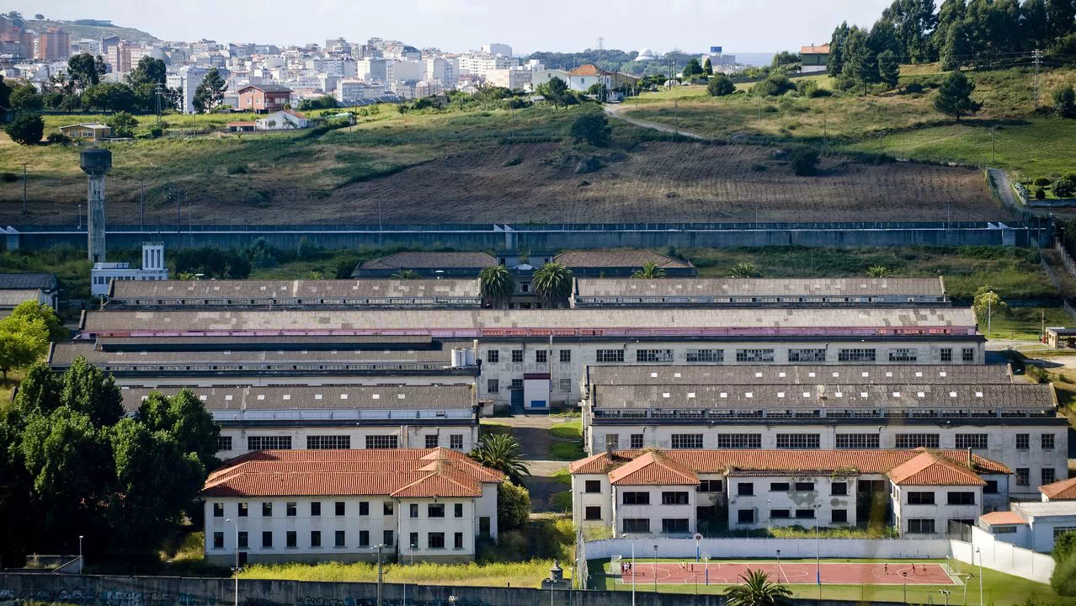
2 1

Slide 17
2 1

Slide 18
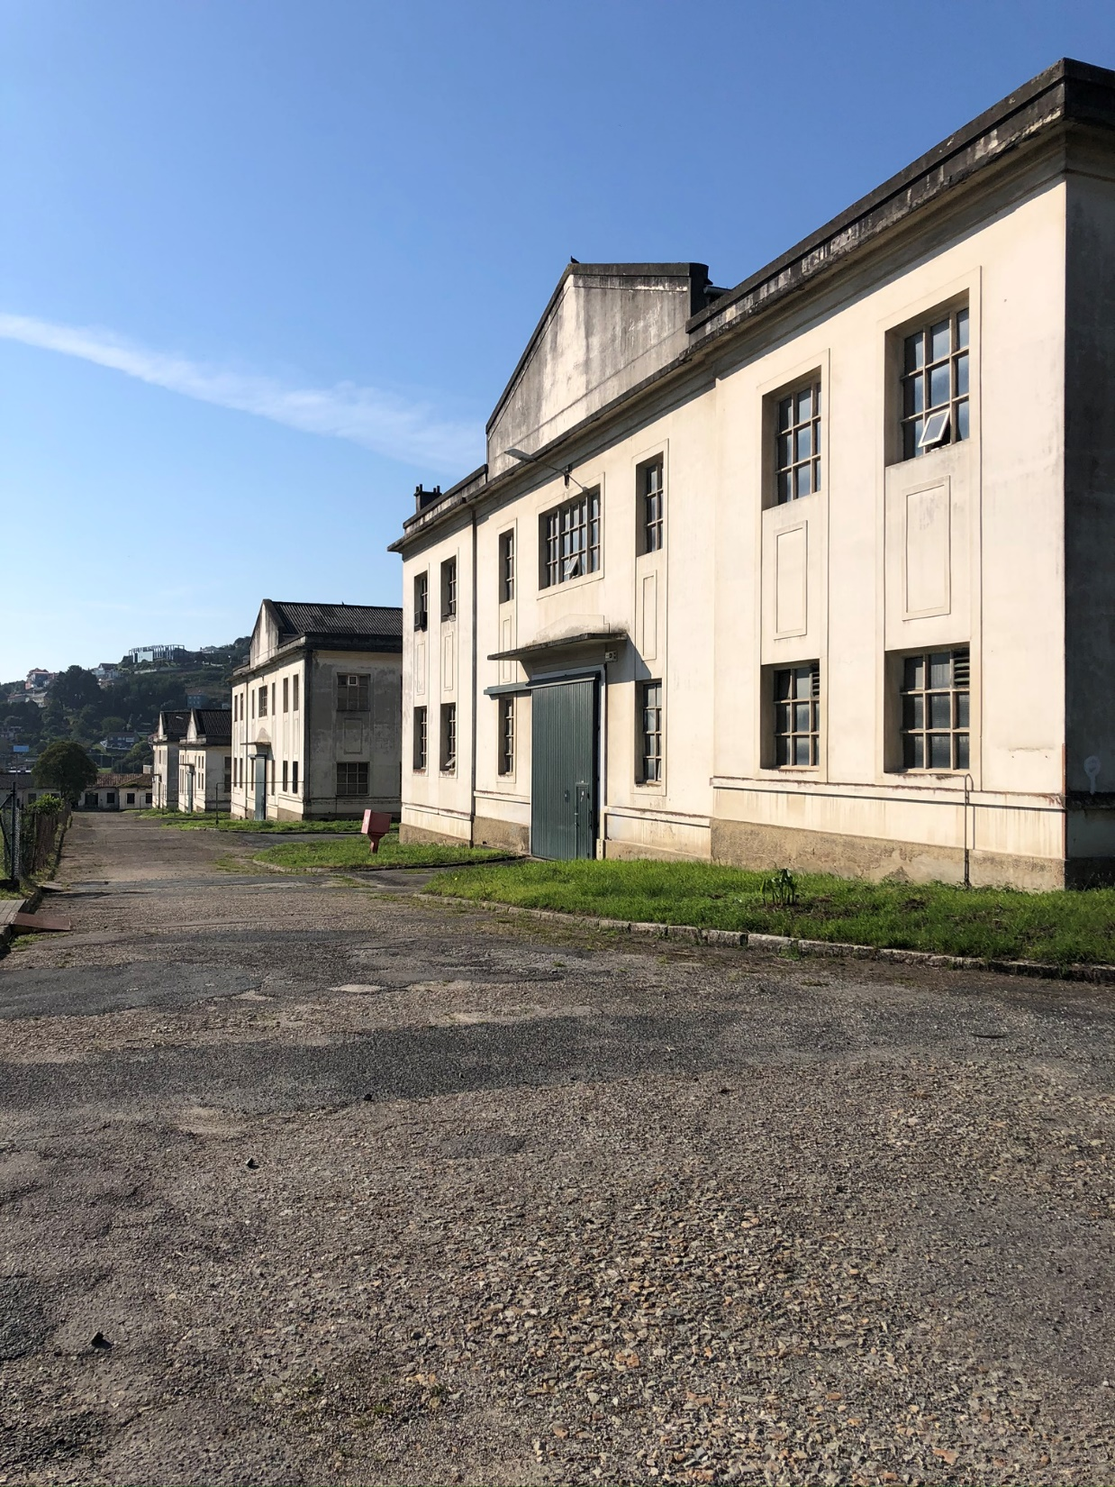
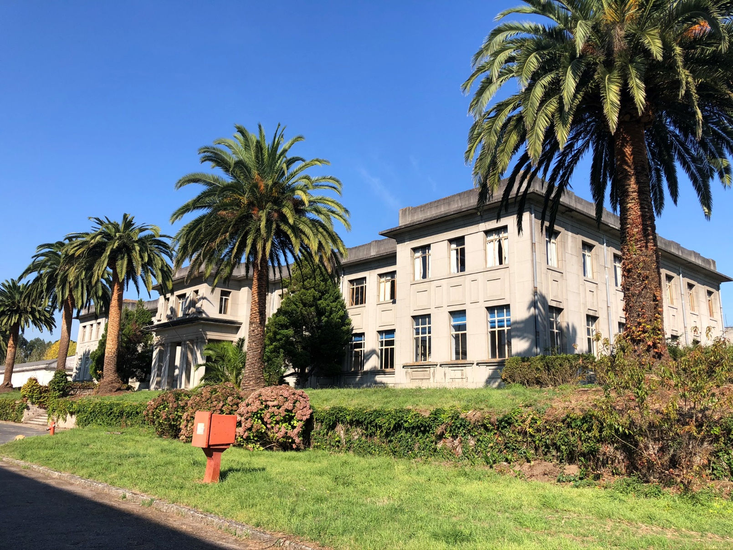
2 1

Slide 19
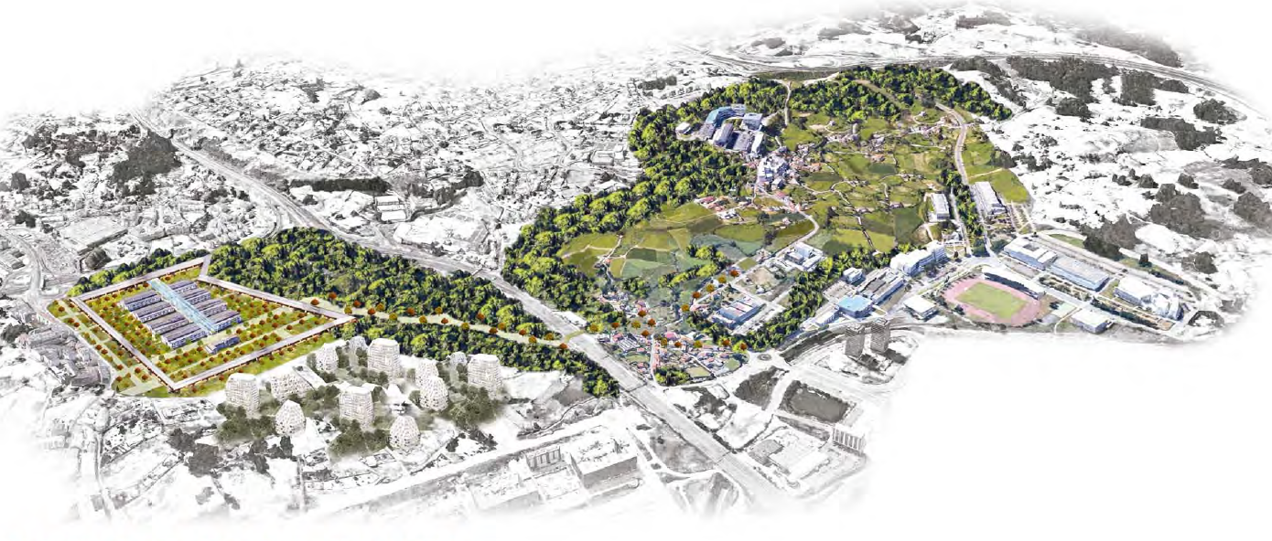
2 1

Slide 20
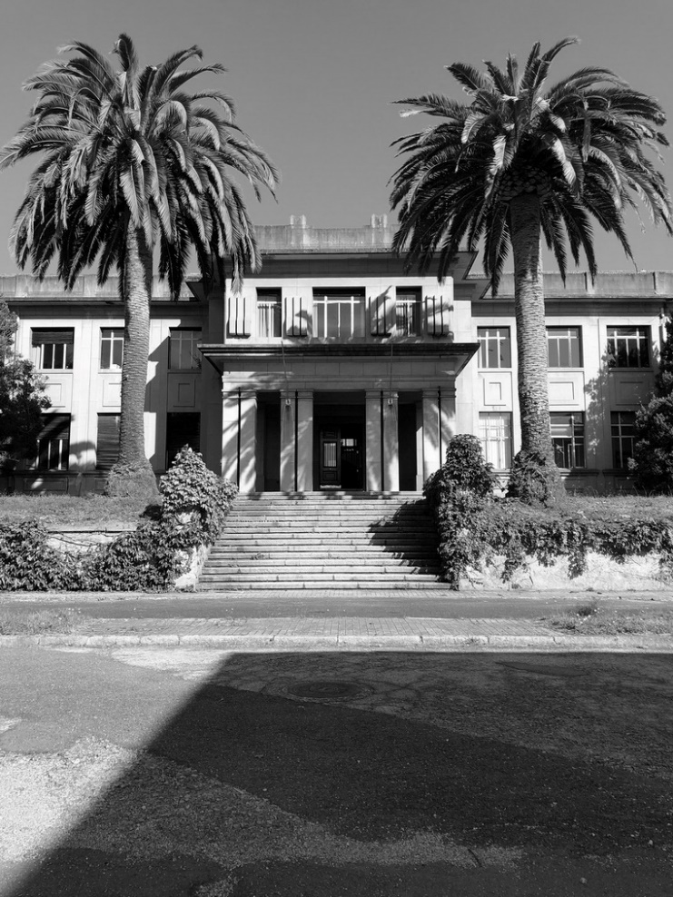
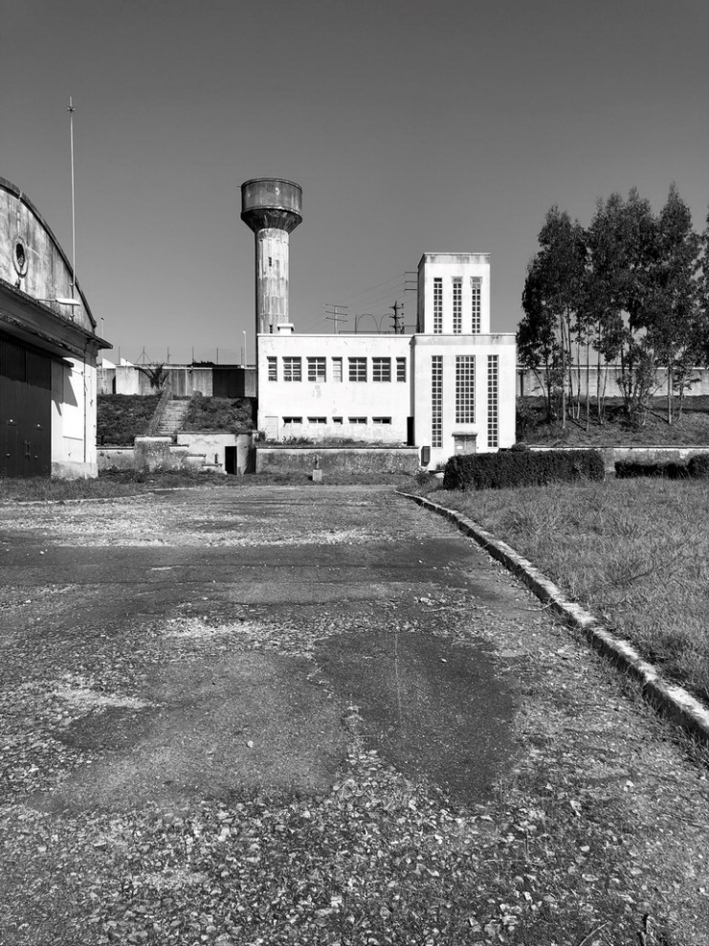
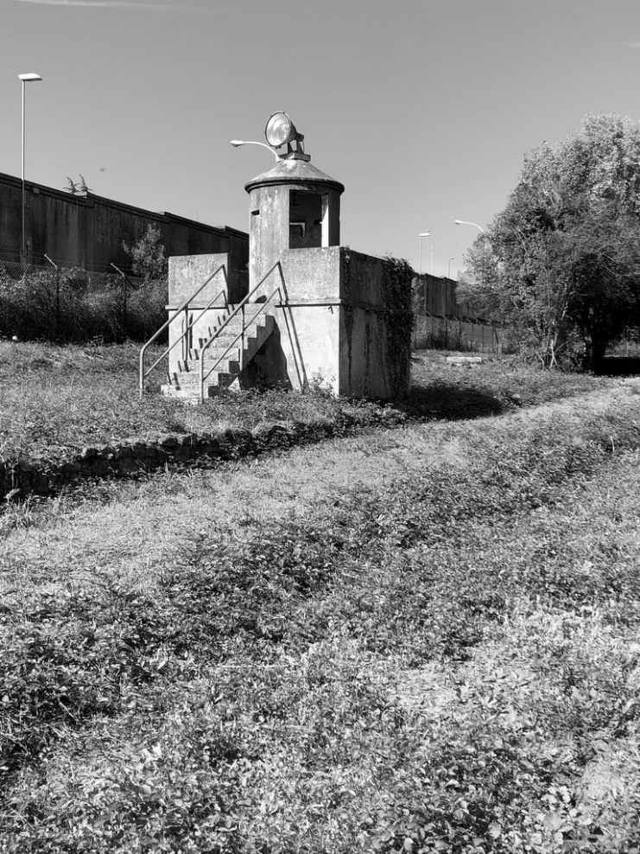
2 1

Slide 21
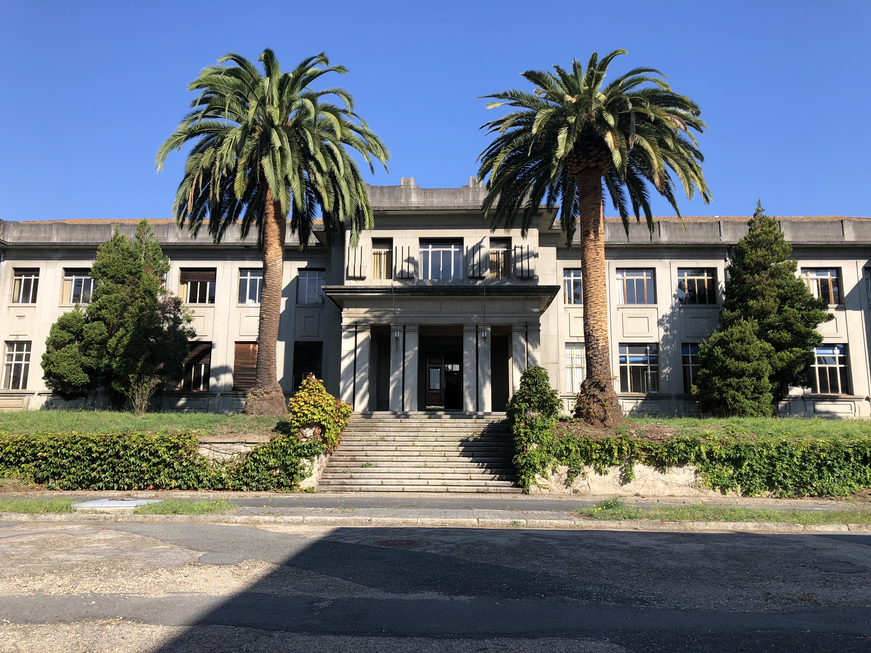
2 1

Slide 22
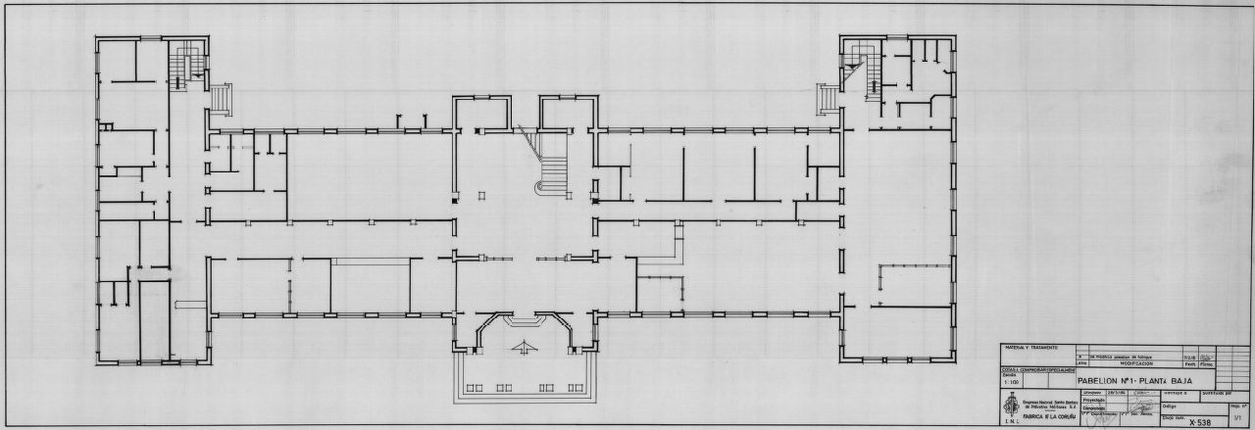
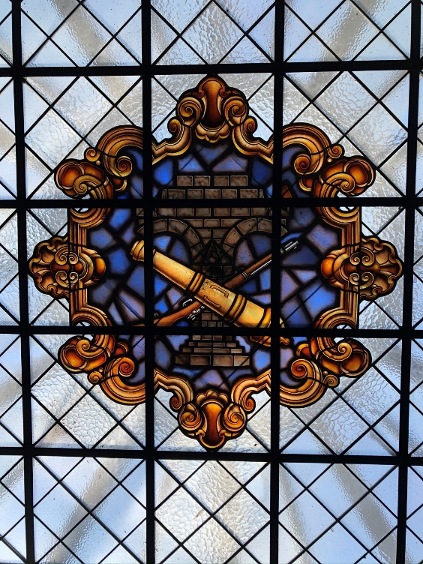
2 1

Slide 23
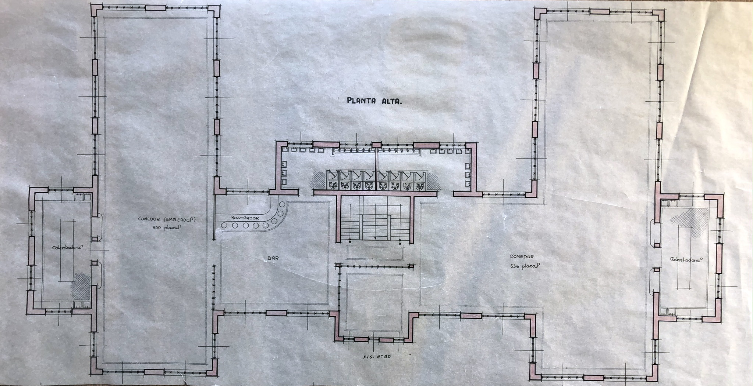
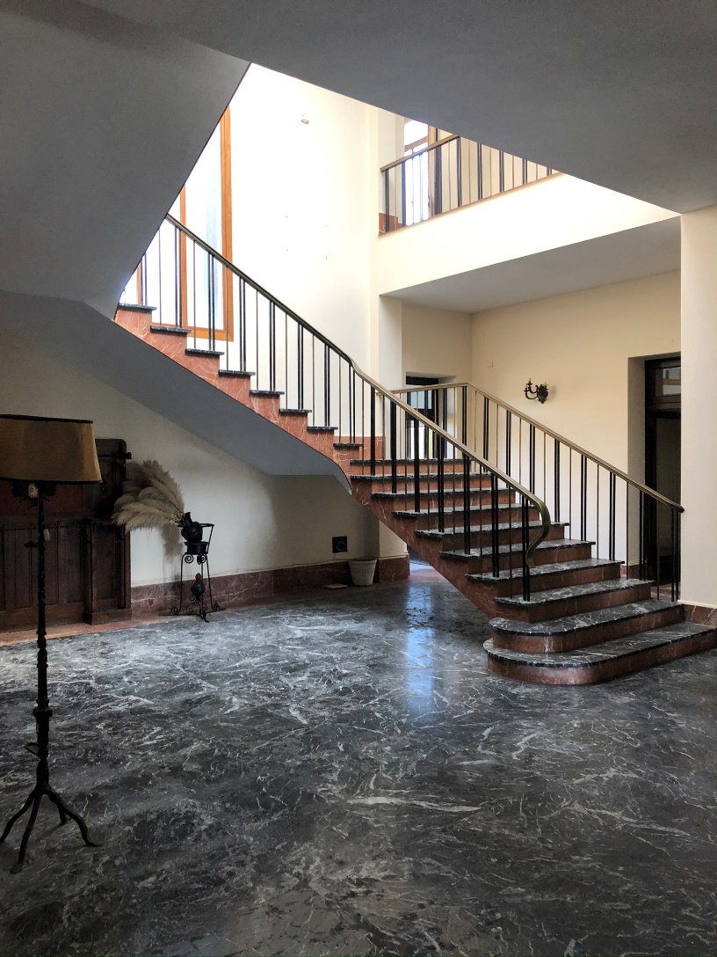
2 1

Slide 24
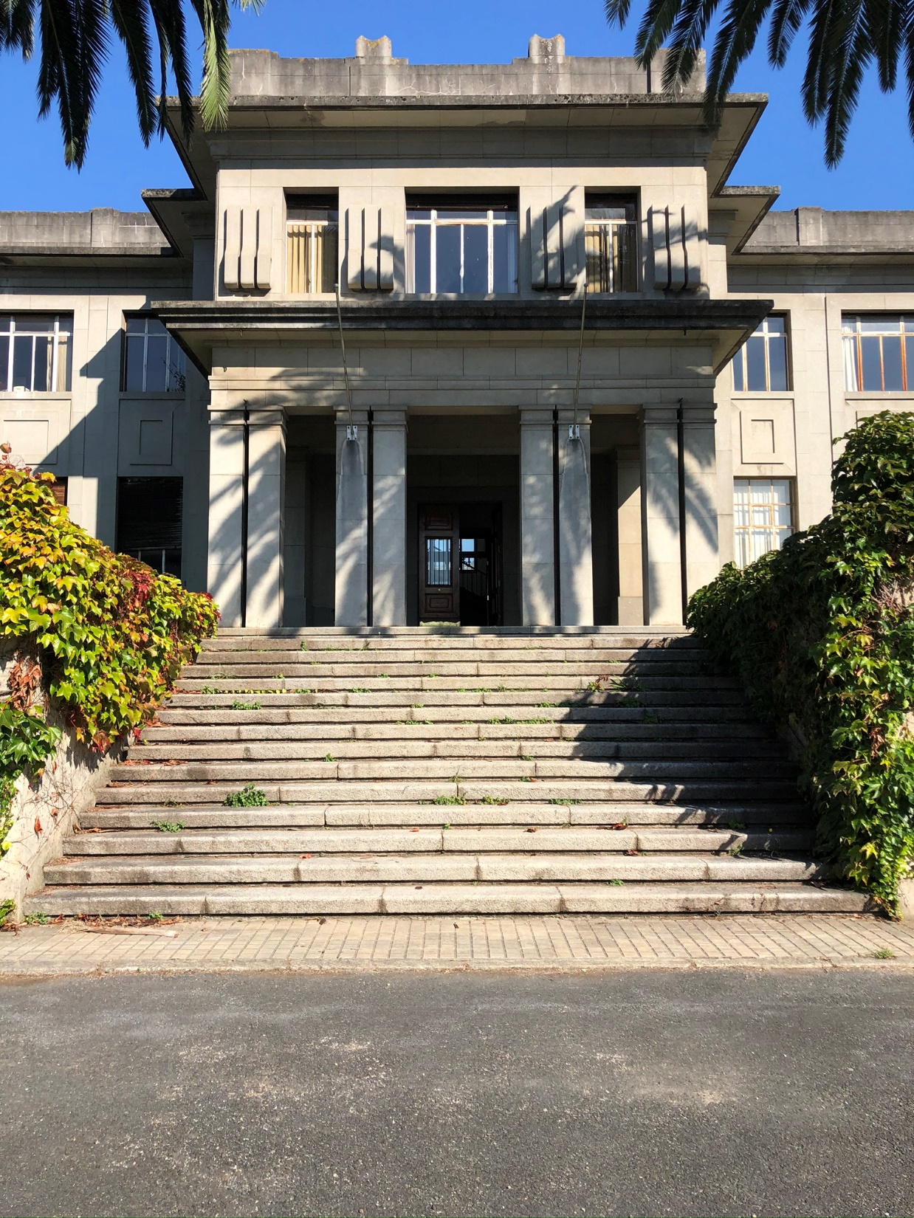
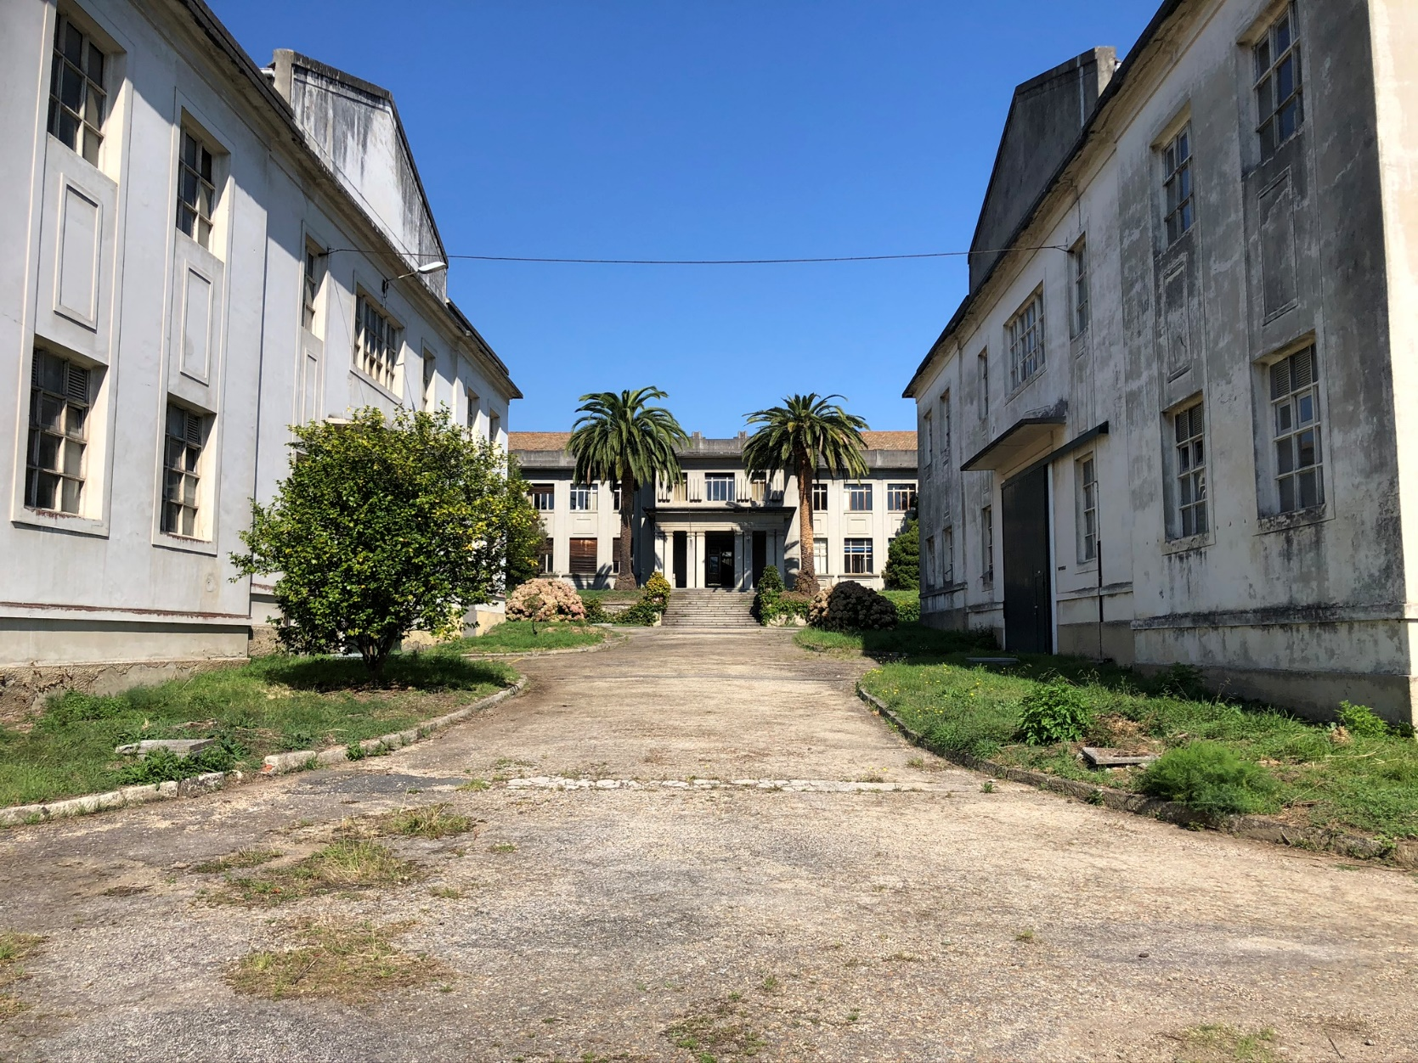
2 1

Slide 25
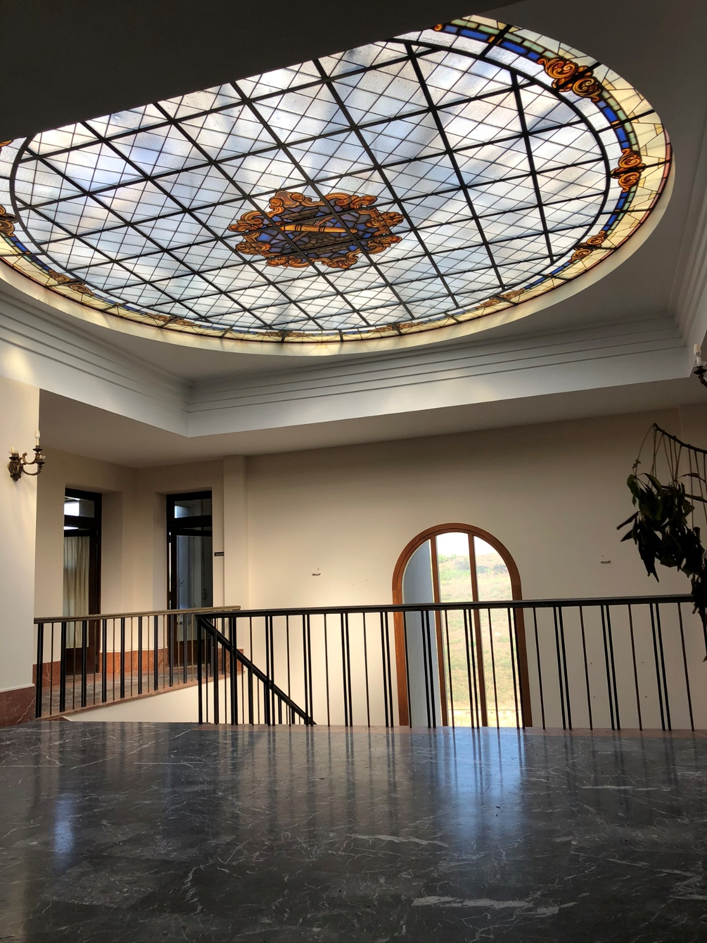
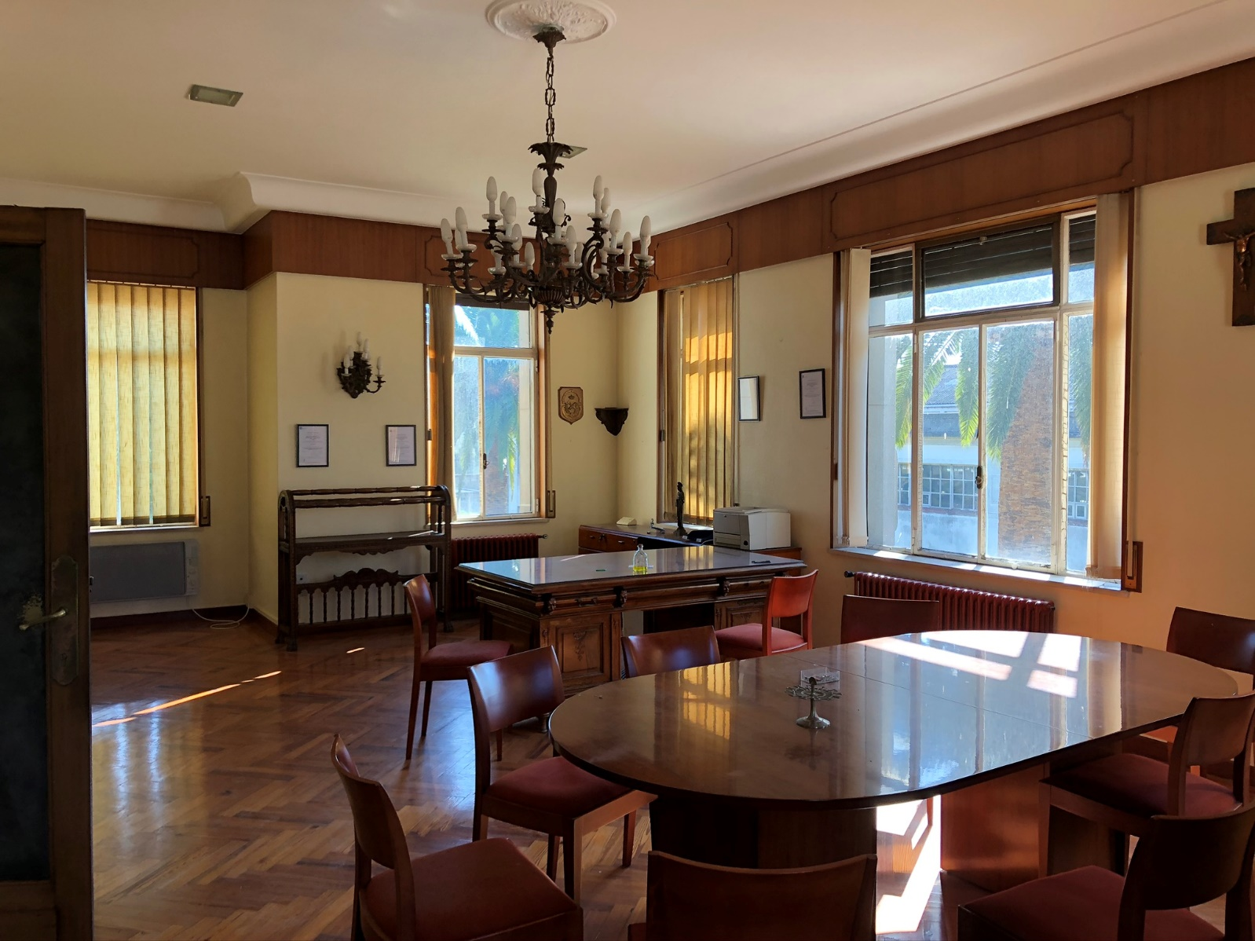
2 1

Slide 26
2 1
Muchas gracias
Many thanks
Merci beaucoup
Vielen Dank
Շատ շնորհակալություն
Moitas grazas

